Slide 1
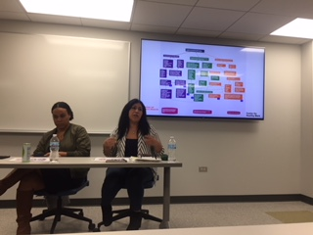
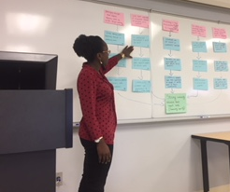
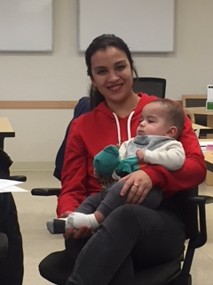
Greater Lawndale Healthy Work Project
CHW Retreat Day 1 Sept 9, 2019

Slide 2
Center for Healthy Work A NIOSH Center of Excellence for Total Worker Health®
A research and education center (est. 2016) to advance the health and well being of workers in Chicago, the state of Illinois, and the nation.
Mission: to remove barriers that impact the health of low wage workers in the increasingly contingent workforce.
Aims: to identify and promote employment programs, practices, and policies that will improve worker and community health locally, across the state, and throughout the nation.
Everyone has the right to a healthy job
Notes:
SLIDE 6: In conveying some of the ideas of how health inequities are produced and maintained I’ll be sharing some of what we are learning in our National Institutes of Occupational Safety and Health-funded Center for Healthy Work at UIC. Specifically, our research core has been engaged in participatory research in Chicago neighborhoods that have a large proportion of the residents engaged in what we refer to as precarious work situations. This is relevant to our topic today as our Center’s mission is to to remove barriers that impact the health of low wage workers in the increasingly contingent workforce and we have a social justice emphasis that Everyone has the right to a healthy job. Barriers to work and health and human rights are of central interests in our research and in this webinar.

Slide 3
Goal/Meta
The goal is to establish a culture of occupational health in communities that will move people from precarious to healthy work by increasing community capacity for addressing healthy work.
El objetivo del Proyecto de trabajos saludables de “Greater Lawndale” es para establecer una cultura de salud ocupacional en comunidades, donde las personas pasaran de precarias condiciones hacia condiciones saludables de trabajo, incrementando la capacidad de la comunidad, enfocándonos en trabajos saludables.

Slide 4
Greater Lawndale Healthy Work Project Aims
Determine the context of, and barriers and pathways to healthy work in two neighborhoods in Chicago that experience high socio-economic hardship: Little Village and North Lawndale.
Build community capacity to recognize worker health as an important determinant of community health, address work-related health in community total worker health efforts, and sustain effective, newly developed community-based worker health promotion interventions.

Slide 5
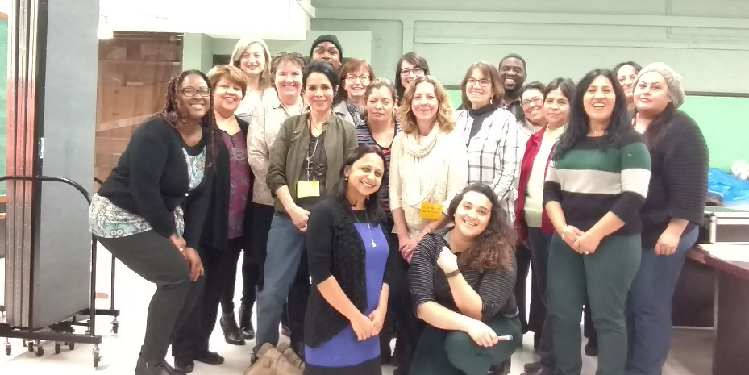
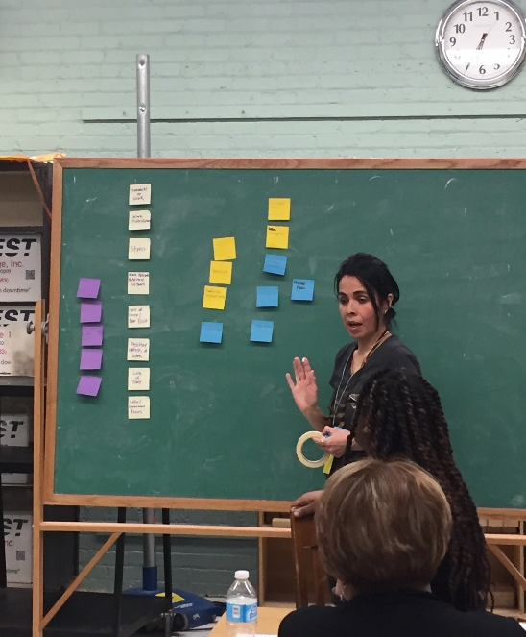
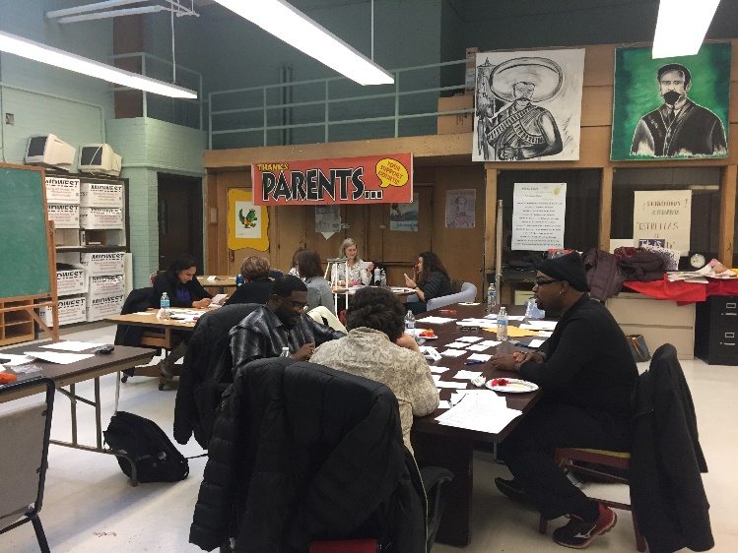
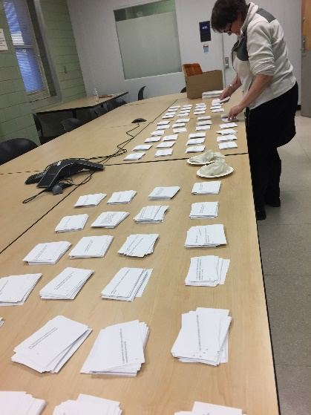
Exploring Precarious Work to Build a Culture of Occupational Health at Community Level
Notes:
SLIDE 6: In the Center for Healthy Work, our study is examining from a CBPR perspective, in which we are researching in partnership with people best informed on the topic, how people experience work at the community level. We are using mixed methods to be able to describe how work functions as a social determinant of health. In doing so we are collecting and piecing together stories of people engaged in precarious work.

Slide 6
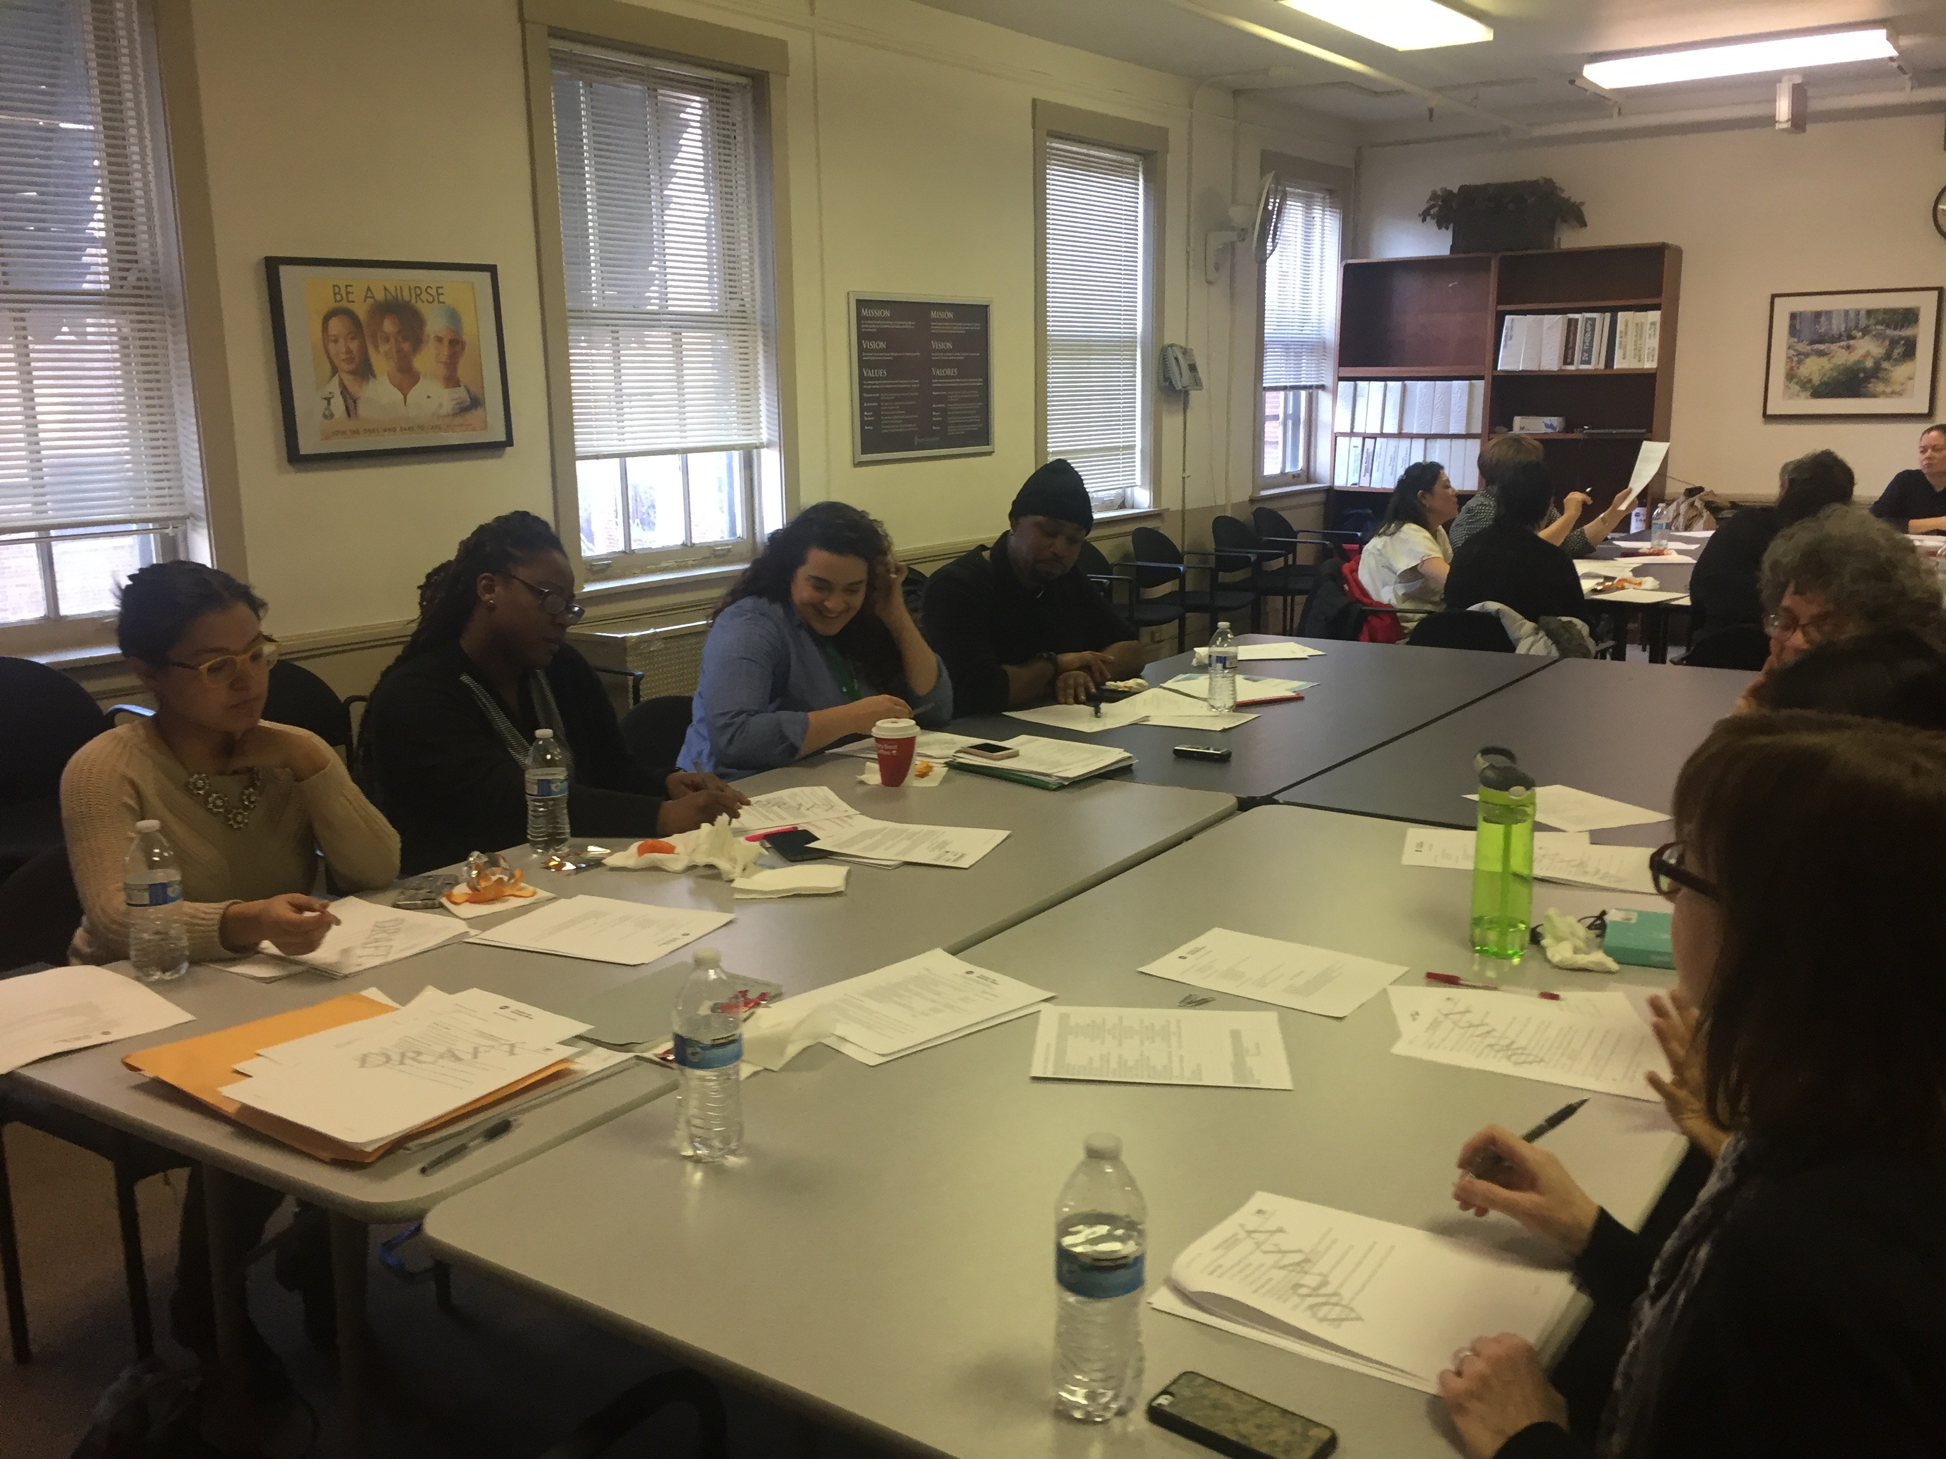
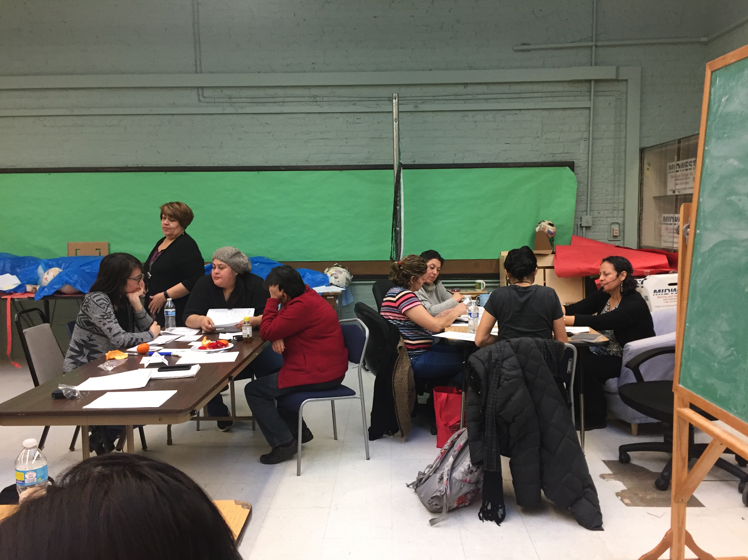
Research Partners
Linda Forst
Kathy Rospenda
Marsha Love
Jennifer Felner
Cindy San Miguel
Ana Genkova
Sarah Hernandez
Sandra Avela
Melissa Creshfield
Aeysha Chaudhry
Journie Raulston
Auturo Carrillo
Fanny Diego
Rev Bobby Smith
Brenda Palms-Barber
Jaqueline TCEP
Lara TCEP
Jeni Hebert-Beirne
Lorraine Conroy
Preethi Pratap
Sylvia Gonzalez
Alisa Velonis
Dolores Castañeda
Rodney Johnson
Alexis Grant
Maria Velazquez-TCEP
Patricia Pereda-TCEP
Adriana Magaña
Yvette Castañeda
Adlaide Holloway - SUHI
Suzanne Zoheri-SAH
Teresa Berumen-SAH
Madeline Woodberry-SUHI
Robert Calhoun-SAH
Angelica Rosales-SAH

Slide 7
Community-based Participatory Research
- Is a collaborative approach to research
- Equitably involves all partners
- Places primacy on the community’s issues of interest
- Recognizes the unique strengths that each bring
Researcher– research training and skills, funding, institutional support
Community partner – local knowledge, relationships in the community, personal stake in the research, ability to sustain interventions/changes
- Focuses on: social science + social activism ➔ social change
Notes:
Partners are academics, or Public health professionals, and community members.
Creating opportunities for social change through science and activism. Goal of Public Health.
Researchers transform tools for community members to analyze and decide on action
Community members transfer their expert content and meaning to researchers in pursuit of knowledge and application.

Slide 8
Method | Research Question
Interviews/ Entrevistas | What are the community’s needs and assets with respect to work?
Focus Groups/ Grupos de Enfoque | How do residents experience work? How does work impact health?
Community Health Survey/ Encuesta de Salud Comunitaria | What are the characteristics, barriers, pathways to work?
Concept Mapping/ Creación de mapas de ideas Y1 | FQ: “When I think of my work situation, or people who live in my community in similar work situations, one way work impacts our health (good or bad) is ____.”

Slide 9
Research Question | Method | Dissemination
What are the community’s needs and assets with respect to work? | Interview | APHA 2019 Manuscript in Development
How do residents experience work? How does work impact health? | Focus Group | Composite Stories Community Report GLHW Conceptual Model
What are the characteristics, barriers, pathways to work? | Community Health Survey | Stress and Health 2019 SCRA Symposium 2019
How do residents perceive work impacts their health? | Concept Mapping | APHA 2019 AJIM Under Revise and Resubmit Review SCRA Symposium 2019 GLHW Conceptual Model
Synthesis of Existing Data Sources | Secondary Data Analysis | Masters Thesis
What are the characteristics of workplaces in GL? | Investigation Observation | WWW Dataset Manuscript in development
What are the health needs of street vendors? | Secondary Data Analysis Observation | Poster Quilt

Slide 10
Greater Lawndale Healthy Work Project
Road Map 9/1/16-8/31/21
Organized Greater Lawndale Healthy Work Community Research Team
Concept Mapping
identified how residents see work impacting health
Interviews
Asked key community stakeholders what are key issues
Checked with with community residents on emerging findings
Focus Groups
Asked residents about work experiences
Survey
Ask residents about work characteristics
Action Mapping
Identify actions to take based on research findings
Test Actions
See which actions work best
Build a Culture of Occupational Health
We are here

Slide 11
Here is What We have Learned

Slide 12
FOCUS GROUPS
Jeni

Slide 13
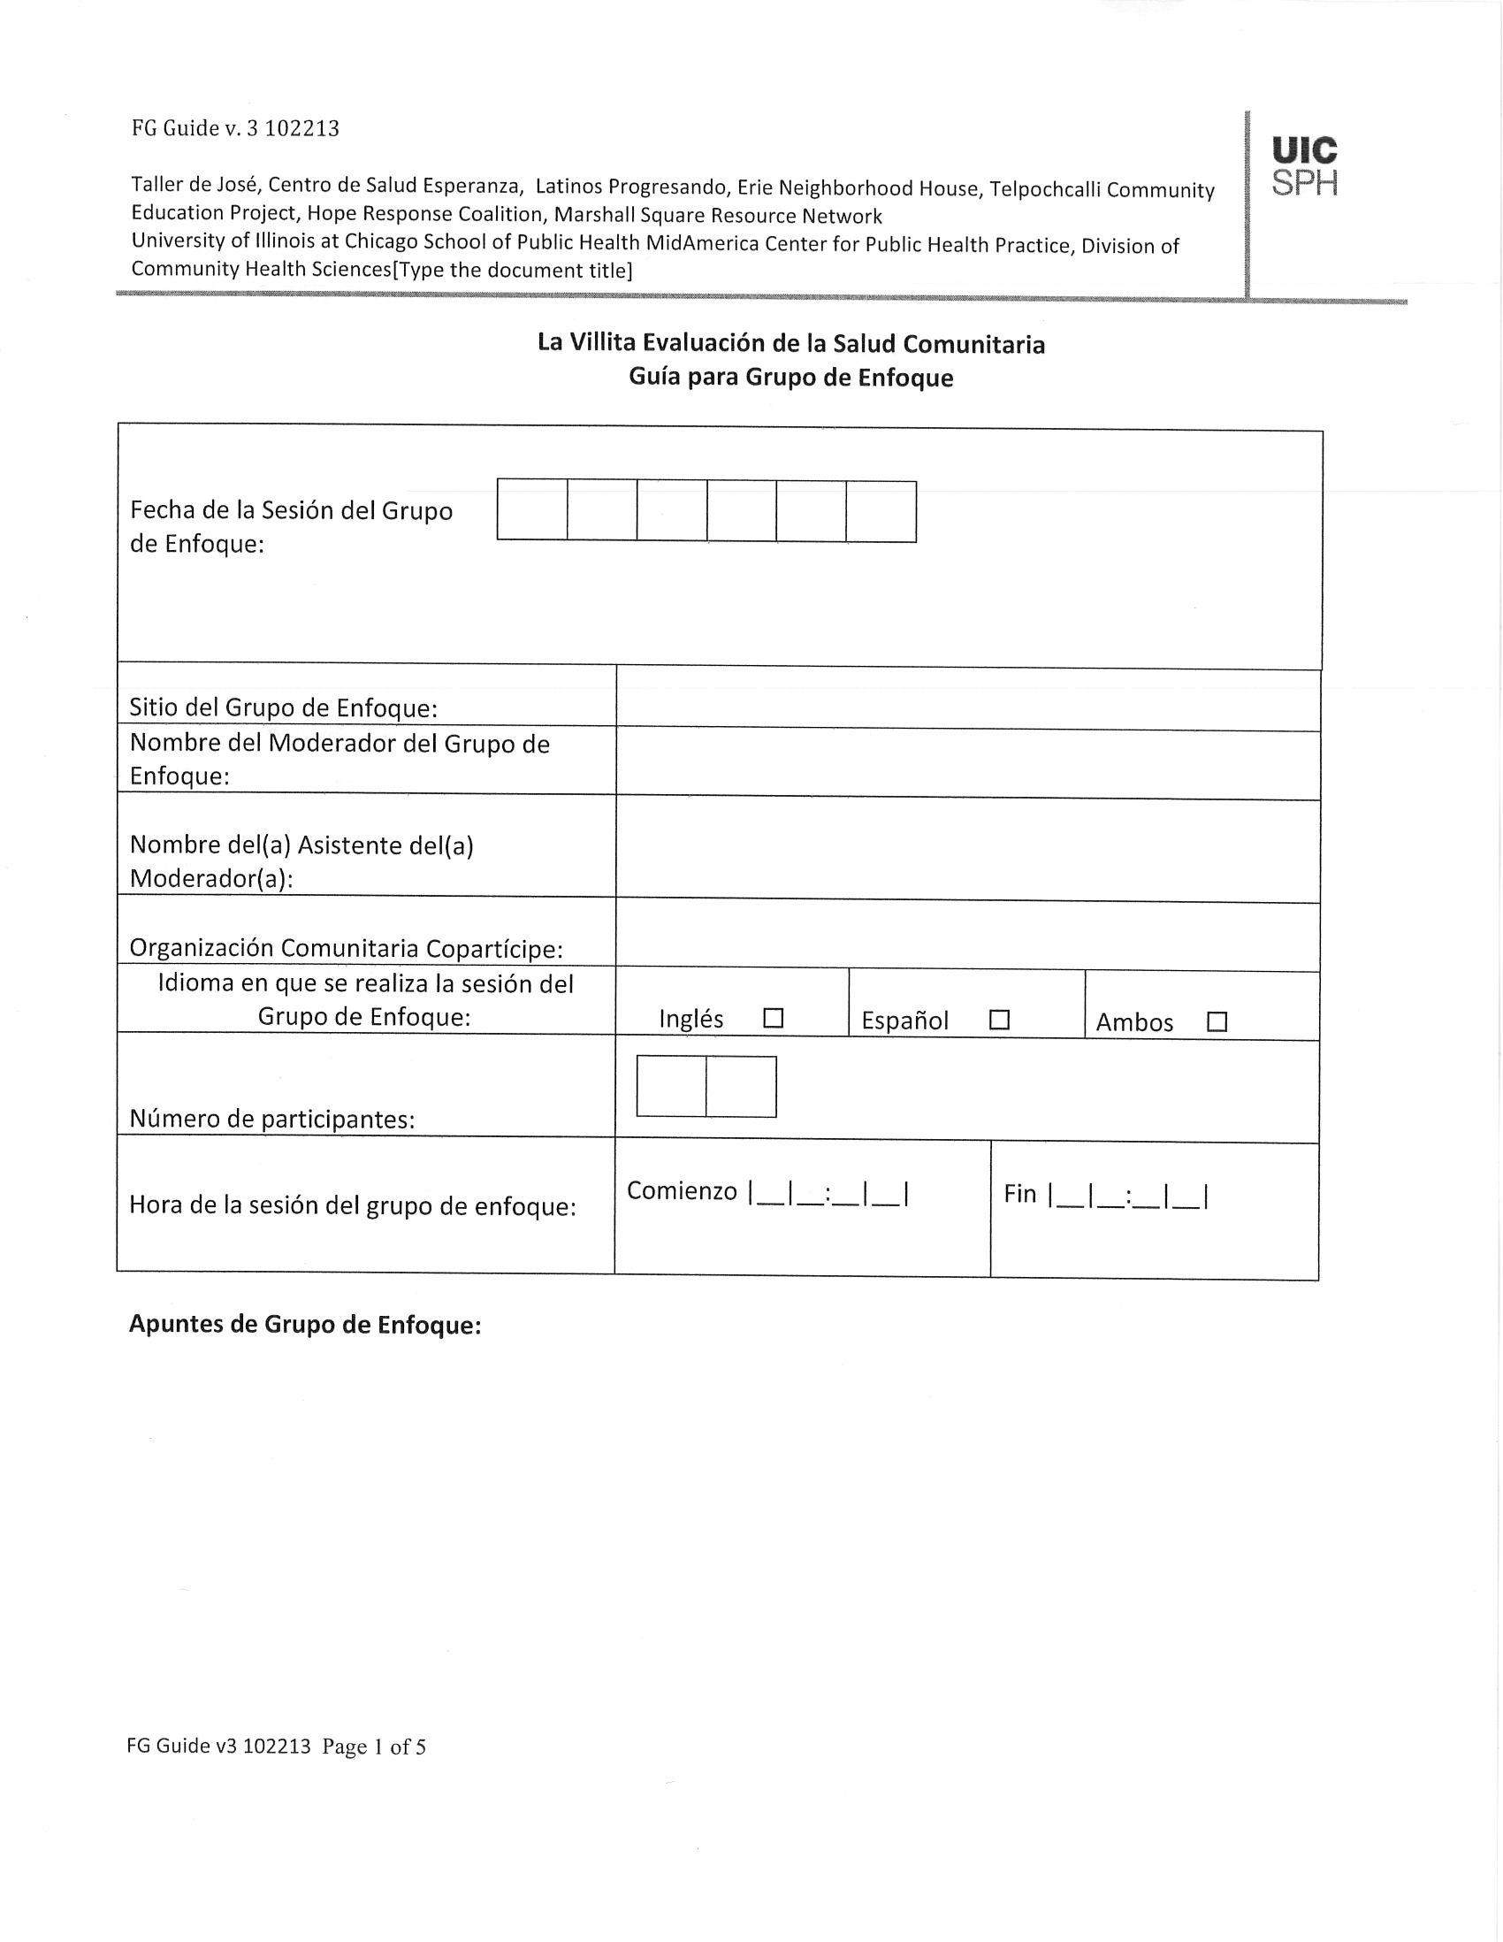
Focus Groups
6 in each Community Area – TOTAL 12
Focus Group Training for CR
CRs redeveloped FG questions
90 minutes
6-10 community residents
$25 gift certificate

Slide 14
Focus Groups Description
LITTLE VILLAGE
Focus Group ID | Community area | Who led focus group | Who participated in focus group | Number of participants | Length of focus group
FG041517AM | Little Village | Adriana and Dolores | Residents engaged in varied job types | 6 | 60 minutes
FG050317PP | Little Village | Patricia and Trini | English as a Second Language | 12 | 46 minutes
FG040717TB | Little Village | Tere and Adriana | Community Health Workers | 8 | 107 minutes
FG0400917DC | Little Village | Dolores and Adriana | Street Vendors | 5 | 120 minutes
FG041217DC | Little Village | Dolores | Day Laborers | 5 | 74 minutes
FG041217PP | Little Village | Patricia, Dolores, Yvette, Adriana | LV Community Researchers | 5 | 88 minutes
NORTH LAWNDALE
Focus Group ID | Community area | Who led focus group | Who participated in focus group | Number of participants | Length of focus group
FG042017AH | North Lawndale | Addy and Fatima | SUHI Staff | 5 | 38 minutes
FG042417FP | North Lawndale | Fatima and Addy | Community Health Workers | 7 | 50 minutes
FG042517SZ | North Lawndale | Suzanne and Richard | Learning Center participants | 6 | 80 minutes
FG041217JF | North Lawndale | Jenn | NL Community Researchers | 5 | 75 minutes
FG050817SZ | North Lawndale | Suzanne | Young people seeking services | 6 | 65 minutes
FG052817SZ | North Lawndale | Suzanne and Richard | Church members | 10 | 62 minutes

Slide 15
Focus Group Participants
 | Total |  | Little Village |  | North Lawndale |  | Other
 | N | % | N | % | N | % | N | %
Community Area | 77 | 100% | 40 | 52% | 34 | 42% | 3 | 6%
Employment Status
Employed for wages | 29 | 38% | 3 | 8% | 25 | 78% | 1 | 20%
Self-employed | 6 | 8% | 4 | 10% | 2 | 6% | 0 | 0%
Out of work > 1 year | 0 | 0% | 0 | 0% | 0 | 0% | 0 | 0%
Out of work < 1 year | 2 | 3% | 1 | 3% | 1 | 3% | 0 | 0%
Homemaker | 1 | 1% | 1 | 3% | 0 | 0% | 0 | 0%
Student | 5 | 6% | 1 | 3% | 3 | 9% | 1 | 20%
Retired | 2 | 3% | 0 | 0% | 0 | 0% | 2 | 40%
Unable to work | 1 | 1% | 0 | 0% | 0 | 0% | 1 | 20%
Missing | 34 | 44% | 30 | 75% | 1 | 3% | 0 | 0%

Slide 16
Developing Codebook for Analysis: Focus Group Participatory Qualitative Data Analysis Think Tanks
Selected Audio Identified
Think Tank members meet by Community Area/Language
Listen and debrief the meaning of the audio clip
Build a codebook by identifying codes from the debriefing discussion
Apply codebook to data
Adapt/Adjust codebook/ check reliability of coders
The purpose of the GLHW FG QDA is to engage in participatory data analysis that results in a comprehensive, community-driven codebook and engage in thematic analysis. This codebook is used to code the audio file.

Slide 17
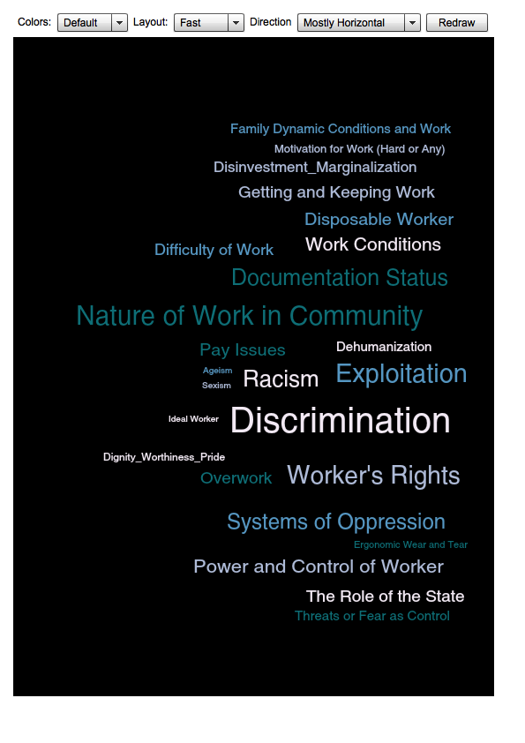
Steps to the Analysis
Apply codes to the data
Select analytic codes to examine
Examine code patterns and relationships
Code Frequency
Table
Word Cloud
Code Co-Occurrence
Spreadsheet
Focus Group Type by Count
Share with CRT; Revisit Data
– focus on relationships/
how experiences are embodied

Slide 18
Focused Code Frequency in Greater Lawndale

Slide 19
Code-Co-Occurrence
 | 1 | 2 | 3 | 4 | 5 | 6 | 7 | 8 | 9 | 10 | 11 | 12 | 13 | 14 | 15 | 16 | 17 | 18 | 19 | 20 | 21 | 22 | 23 | 24 | 25 | 26 | 27 | 28 | 29 | 30 | 31 | TOTALS
1 Barriers to Work |  | 4 | 2 |  |  | 2 | 1 | 20 | 2 | 12 | 11 | 1 | 2 | 1 | 2 |  | 2 | 1 |  | 2 | 9 |  | 1 | 2 | 10 | 3 | 2 | 12 | 2 |  | 3 | 109
2 Challenges at Work |  |  | 4 | 1 | 10 | 16 | 2 | 19 |  | 10 | 11 | 2 | 4 | 16 | 27 | 13 | 12 | 25 | 4 | 2 | 4 | 2 |  | 7 | 13 | 11 | 6 | 6 |  | 5 | 16 | 252
3 Community Needs |  |  |  | 4 | 2 | 2 | 2 | 10 |  | 7 | 8 | 1 | 6 |  | 4 |  | 3 |  |  |  |  |  |  |  |  | 2 | 1 | 2 | 2 | 1 | 4 | 67
4 Community Strengths |  |  |  |  | 1 |  |  | 2 |  | 1 | 1 |  | 4 |  |  |  | 1 | 1 |  |  |  |  |  | 2 |  | 1 | 1 |  |  |  |  | 20
5 Dehumanization |  |  |  |  |  | 4 |  | 7 |  | 5 | 4 |  |  | 2 | 8 | 4 | 6 | 5 | 1 |  |  |  |  | 1 |  | 3 | 2 |  |  | 1 | 3 | 69
6 Difficulty of Work |  |  |  |  |  |  |  | 9 |  | 8 | 10 | 1 |  | 2 | 12 | 8 | 4 | 7 | 1 |  |  |  |  | 1 | 3 | 6 |  |  |  | 1 |  | 97
7 Dignity_Worthiness_Pride |  |  |  |  |  |  |  | 1 |  |  | 1 |  | 1 | 3 | 1 | 1 | 1 | 2 |  |  |  |  |  | 3 | 3 | 3 |  | 1 |  |  | 1 | 27
8 Discrimination |  |  |  |  |  |  |  |  | 1 | 25 | 29 | 3 | 2 | 8 | 14 | 6 | 11 | 7 | 2 |  |  |  | 1 | 1 | 1 | 7 | 2 | 2 | 2 | 3 | 4 | 199
9 Ageism |  |  |  |  |  |  |  |  |  |  |  |  |  |  |  |  |  |  |  |  | 1 |  | 1 |  |  |  |  |  |  |  |  | 5
10 Documentation Status |  |  |  |  |  |  |  |  |  |  | 19 | 2 | 1 | 4 | 9 | 6 | 6 | 5 | 2 | 2 |  |  |  |  |  | 5 | 1 | 2 |  | 3 | 5 | 140
11 Racism |  |  |  |  |  |  |  |  |  |  |  | 2 | 3 | 6 | 13 | 9 | 7 | 7 | 4 | 1 | 2 | 1 |  | 1 | 4 | 5 | 1 | 4 | 2 | 5 | 3 | 174
12 Sexism |  |  |  |  |  |  |  |  |  |  |  |  |  |  | 2 |  | 2 |  |  |  |  |  |  |  |  | 1 |  |  |  |  |  | 17
13 Disinvestment_Marginalization |  |  |  |  |  |  |  |  |  |  |  |  |  | 1 |  |  |  |  |  |  | 1 |  |  | 1 | 2 | 1 | 3 | 4 | 1 | 3 | 4 | 44
14 Disposable Worker |  |  |  |  |  |  |  |  |  |  |  |  |  |  | 8 | 3 | 2 | 8 | 3 | 1 | 2 | 1 |  | 4 | 7 | 6 |  | 3 |  | 3 | 7 | 101
15 Exploitation |  |  |  |  |  |  |  |  |  |  |  |  |  |  |  | 14 | 18 | 14 | 3 | 1 | 2 | 1 | 1 | 3 | 8 | 8 |  | 5 | 1 | 6 | 5 | 190
16 Overwork |  |  |  |  |  |  |  |  |  |  |  |  |  |  |  |  | 6 | 7 | 5 | 1 | 2 | 1 |  | 3 | 5 | 5 |  | 2 |  | 5 | 4 | 110
17 Pay Issues |  |  |  |  |  |  |  |  |  |  |  |  |  |  |  |  |  | 5 | 1 |  |  |  | 1 | 2 | 4 | 9 | 2 | 2 |  | 2 | 3 | 112
18 Work Conditions |  |  |  |  |  |  |  |  |  |  |  |  |  |  |  |  |  |  | 3 | 2 | 2 | 1 |  | 4 | 6 | 7 | 5 | 2 |  | 4 | 9 | 139
19 Ergonomic Wear and Tear |  |  |  |  |  |  |  |  |  |  |  |  |  |  |  |  |  |  |  | 1 | 2 | 1 |  | 1 | 2 |  |  | 2 |  | 2 | 3 | 43
20 Family Dynamic Conditions and Work |  |  |  |  |  |  |  |  |  |  |  |  |  |  |  |  |  |  |  |  | 2 | 2 |  | 3 | 2 | 3 | 2 | 1 |  | 1 | 4 | 33
21 Getting and Keeping Work |  |  |  |  |  |  |  |  |  |  |  |  |  |  |  |  |  |  |  |  |  | 2 | 1 | 4 | 7 | 1 | 1 | 4 |  | 2 | 5 | 56
22 Ideal Worker |  |  |  |  |  |  |  |  |  |  |  |  |  |  |  |  |  |  |  |  |  |  |  | 2 | 2 |  |  | 1 |  | 1 | 1 | 19
23 Issues of Age |  |  |  |  |  |  |  |  |  |  |  |  |  |  |  |  |  |  |  |  |  |  |  |  | 1 |  |  |  |  |  |  | 7
24 Motivation for Work (Hard or Any) |  |  |  |  |  |  |  |  |  |  |  |  |  |  |  |  |  |  |  |  |  |  |  |  | 7 | 6 | 2 | 1 |  | 1 | 3 | 65
25 Nature of Work in Community |  |  |  |  |  |  |  |  |  |  |  |  |  |  |  |  |  |  |  |  |  |  |  |  |  | 7 | 1 | 6 |  | 2 | 5 | 108
26 Power and Control of Worker |  |  |  |  |  |  |  |  |  |  |  |  |  |  |  |  |  |  |  |  |  |  |  |  |  |  | 5 | 3 |  | 3 | 12 | 123
27 Social Support |  |  |  |  |  |  |  |  |  |  |  |  |  |  |  |  |  |  |  |  |  |  |  |  |  |  |  |  |  | 1 | 6 | 44
28 Systems of Oppression |  |  |  |  |  |  |  |  |  |  |  |  |  |  |  |  |  |  |  |  |  |  |  |  |  |  |  |  | 6 | 5 | 3 | 79
29 The Role of the State |  |  |  |  |  |  |  |  |  |  |  |  |  |  |  |  |  |  |  |  |  |  |  |  |  |  |  |  |  |  |  | 16
30 Threats or Fear as Control |  |  |  |  |  |  |  |  |  |  |  |  |  |  |  |  |  |  |  |  |  |  |  |  |  |  |  |  |  |  | 5 | 65
31 Worker's Rights |  |  |  |  |  |  |  |  |  |  |  |  |  |  |  |  |  |  |  |  |  |  |  |  |  |  |  |  |  |  |  | 118
TOTALS
Notes:
I think we only need the top half of this table.

Slide 20
Emergent Themes- Focus Groups
Strained Social Resources: Consequence of Inequities
Systematic Marginalization from Healthy Work: Fractured, Insufficient Pathways
Walter filed a lawsuit with the EEOC after being discriminated against at work because of his race. When he went to apply for another job, he was denied the position even though he was qualified. A receptionist told him “off the record” that it was because they had on record that he filed a lawsuit with the EEOC and was therefore not considered a favorable applicant.
Contextual, Structural Hostility to Maintain Healthy Work
Leticia, a street vendor, has a hard time selling her food on the street when it’s raining or cold. Additionally, she is continually harassed by the police officers and asked for her street vendor permit.
Rights, Agency and Autonomy
Manuel worked at a grocery store for over 15 years from 5am-8pm, 6 days a week. One day he got very sick and was admitted to the hospital. Manuel asked the owner of the grocery store for time off. Instead the owner denied Manuel time off and fired him.

Slide 21
More Focus Group Take Aways
Decent work, while hard to find, is important for one’s personal, family and community health.
Community residents in Greater Lawndale face barriers to finding work, getting work and keeping work that are numerous, rooted in discrimination and systemic oppression.
Insufficient job training, educational opportunities in the community
Not enough decent work
Workers face work situations that are hostile with unsafe work conditions and exploitive employers that impact their physical and mental health.
Hard, repetitive physical work; low wage; no benefits; unpredictable demands
Worker experience unjust situations where worker and human rights are not respected. The employer has all the power to exploit since workers are seen as disposable and profits are valued over people.
Workers work sick to avoid losing job
Workers sacrifice family time
With so many residents, neighbors, family members engaged in unjust work situations, these unfair experiences and conditions become normalized and reduce chance for group action against the injustices.
People know their rights are being violated but need the job to survive.

