Slide 1
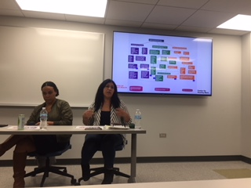
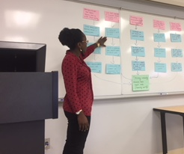
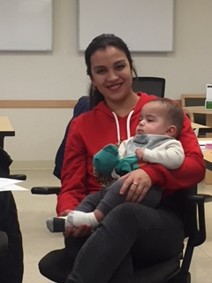
Greater Lawndale Healthy Work Project
CHW Retreat Day 1 Sept 9, 2019

Slide 2
Center for Healthy Work A NIOSH Center of Excellence for Total Worker Health®
A research and education center (est. 2016) to advance the health and well being of workers in Chicago, the state of Illinois, and the nation.
Mission: to remove barriers that impact the health of low wage workers in the increasingly contingent workforce.
Aims: to identify and promote employment programs, practices, and policies that will improve worker and community health locally, across the state, and throughout the nation.
Everyone has the right to a healthy job
Notes:
SLIDE 6: In conveying some of the ideas of how health inequities are produced and maintained I’ll be sharing some of what we are learning in our National Institutes of Occupational Safety and Health-funded Center for Healthy Work at UIC. Specifically, our research core has been engaged in participatory research in Chicago neighborhoods that have a large proportion of the residents engaged in what we refer to as precarious work situations. This is relevant to our topic today as our Center’s mission is to to remove barriers that impact the health of low wage workers in the increasingly contingent workforce and we have a social justice emphasis that Everyone has the right to a healthy job. Barriers to work and health and human rights are of central interests in our research and in this webinar.

Slide 3
Goal/Meta
The goal is to establish a culture of occupational health in communities that will move people from precarious to healthy work by increasing community capacity for addressing healthy work.
El objetivo del Proyecto de trabajos saludables de “Greater Lawndale” es para establecer una cultura de salud ocupacional en comunidades, donde las personas pasaran de precarias condiciones hacia condiciones saludables de trabajo, incrementando la capacidad de la comunidad, enfocándonos en trabajos saludables.

Slide 4
Greater Lawndale Healthy Work Project Aims
Determine the context of, and barriers and pathways to healthy work in two neighborhoods in Chicago that experience high socio-economic hardship: Little Village and North Lawndale.
Build community capacity to recognize worker health as an important determinant of community health, address work-related health in community total worker health efforts, and sustain effective, newly developed community-based worker health promotion interventions.

Slide 5
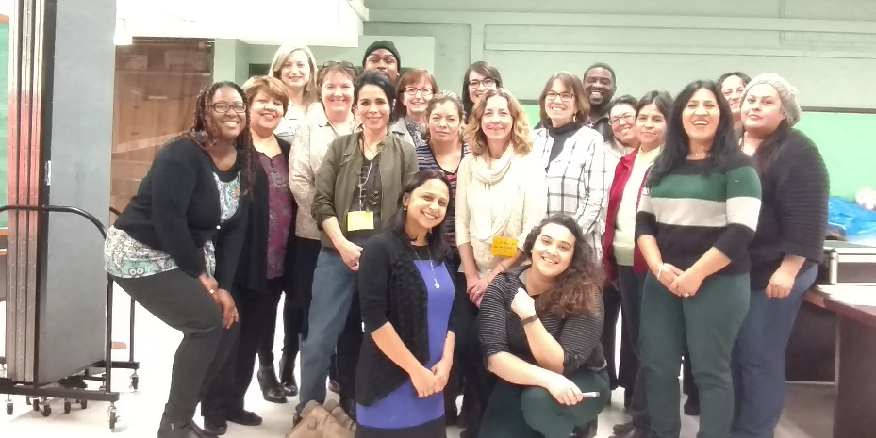
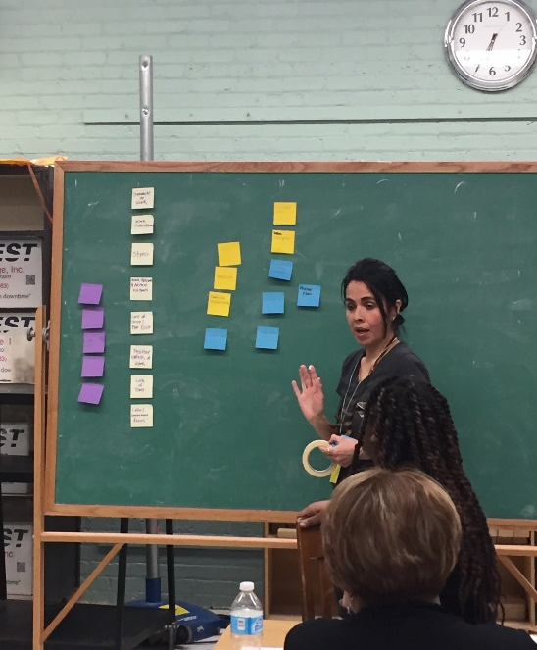
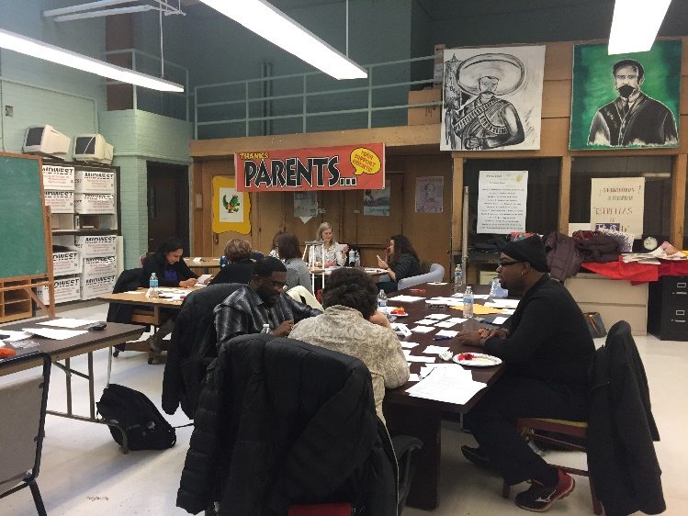
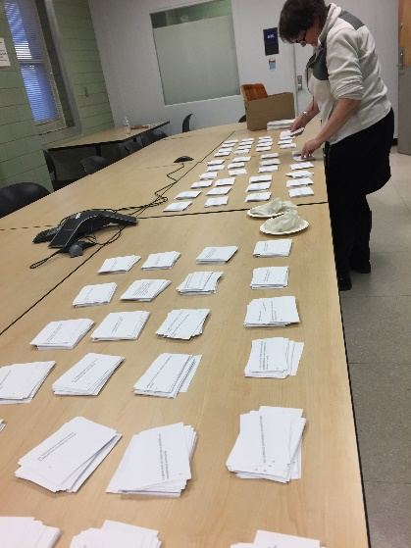
Exploring Precarious Work to Build a Culture of Occupational Health at Community Level
Notes:
SLIDE 6: In the Center for Healthy Work, our study is examining from a CBPR perspective, in which we are researching in partnership with people best informed on the topic, how people experience work at the community level. We are using mixed methods to be able to describe how work functions as a social determinant of health. In doing so we are collecting and piecing together stories of people engaged in precarious work.

Slide 6
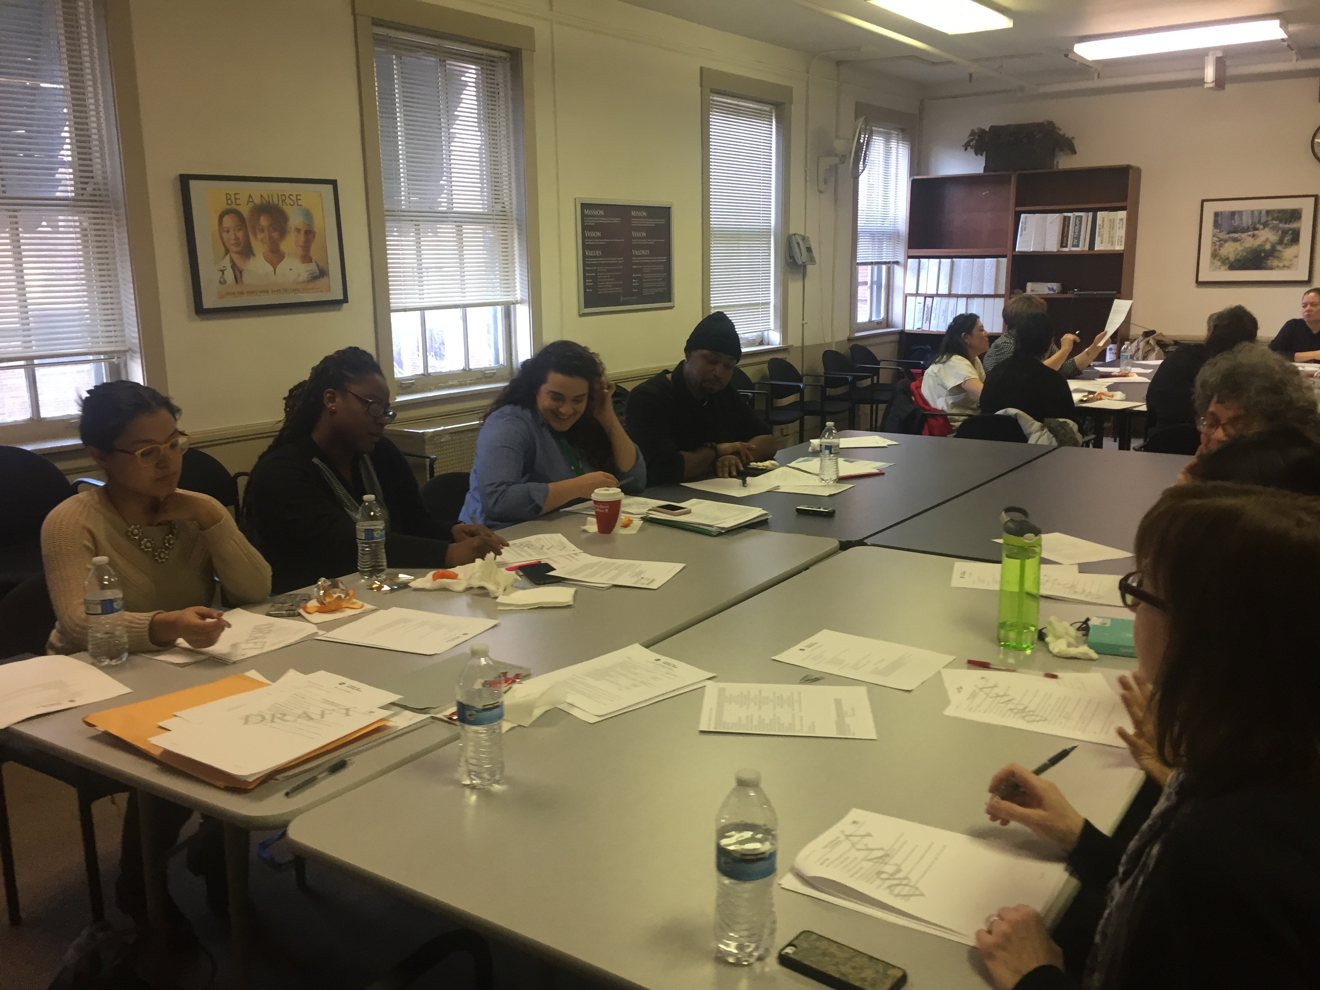
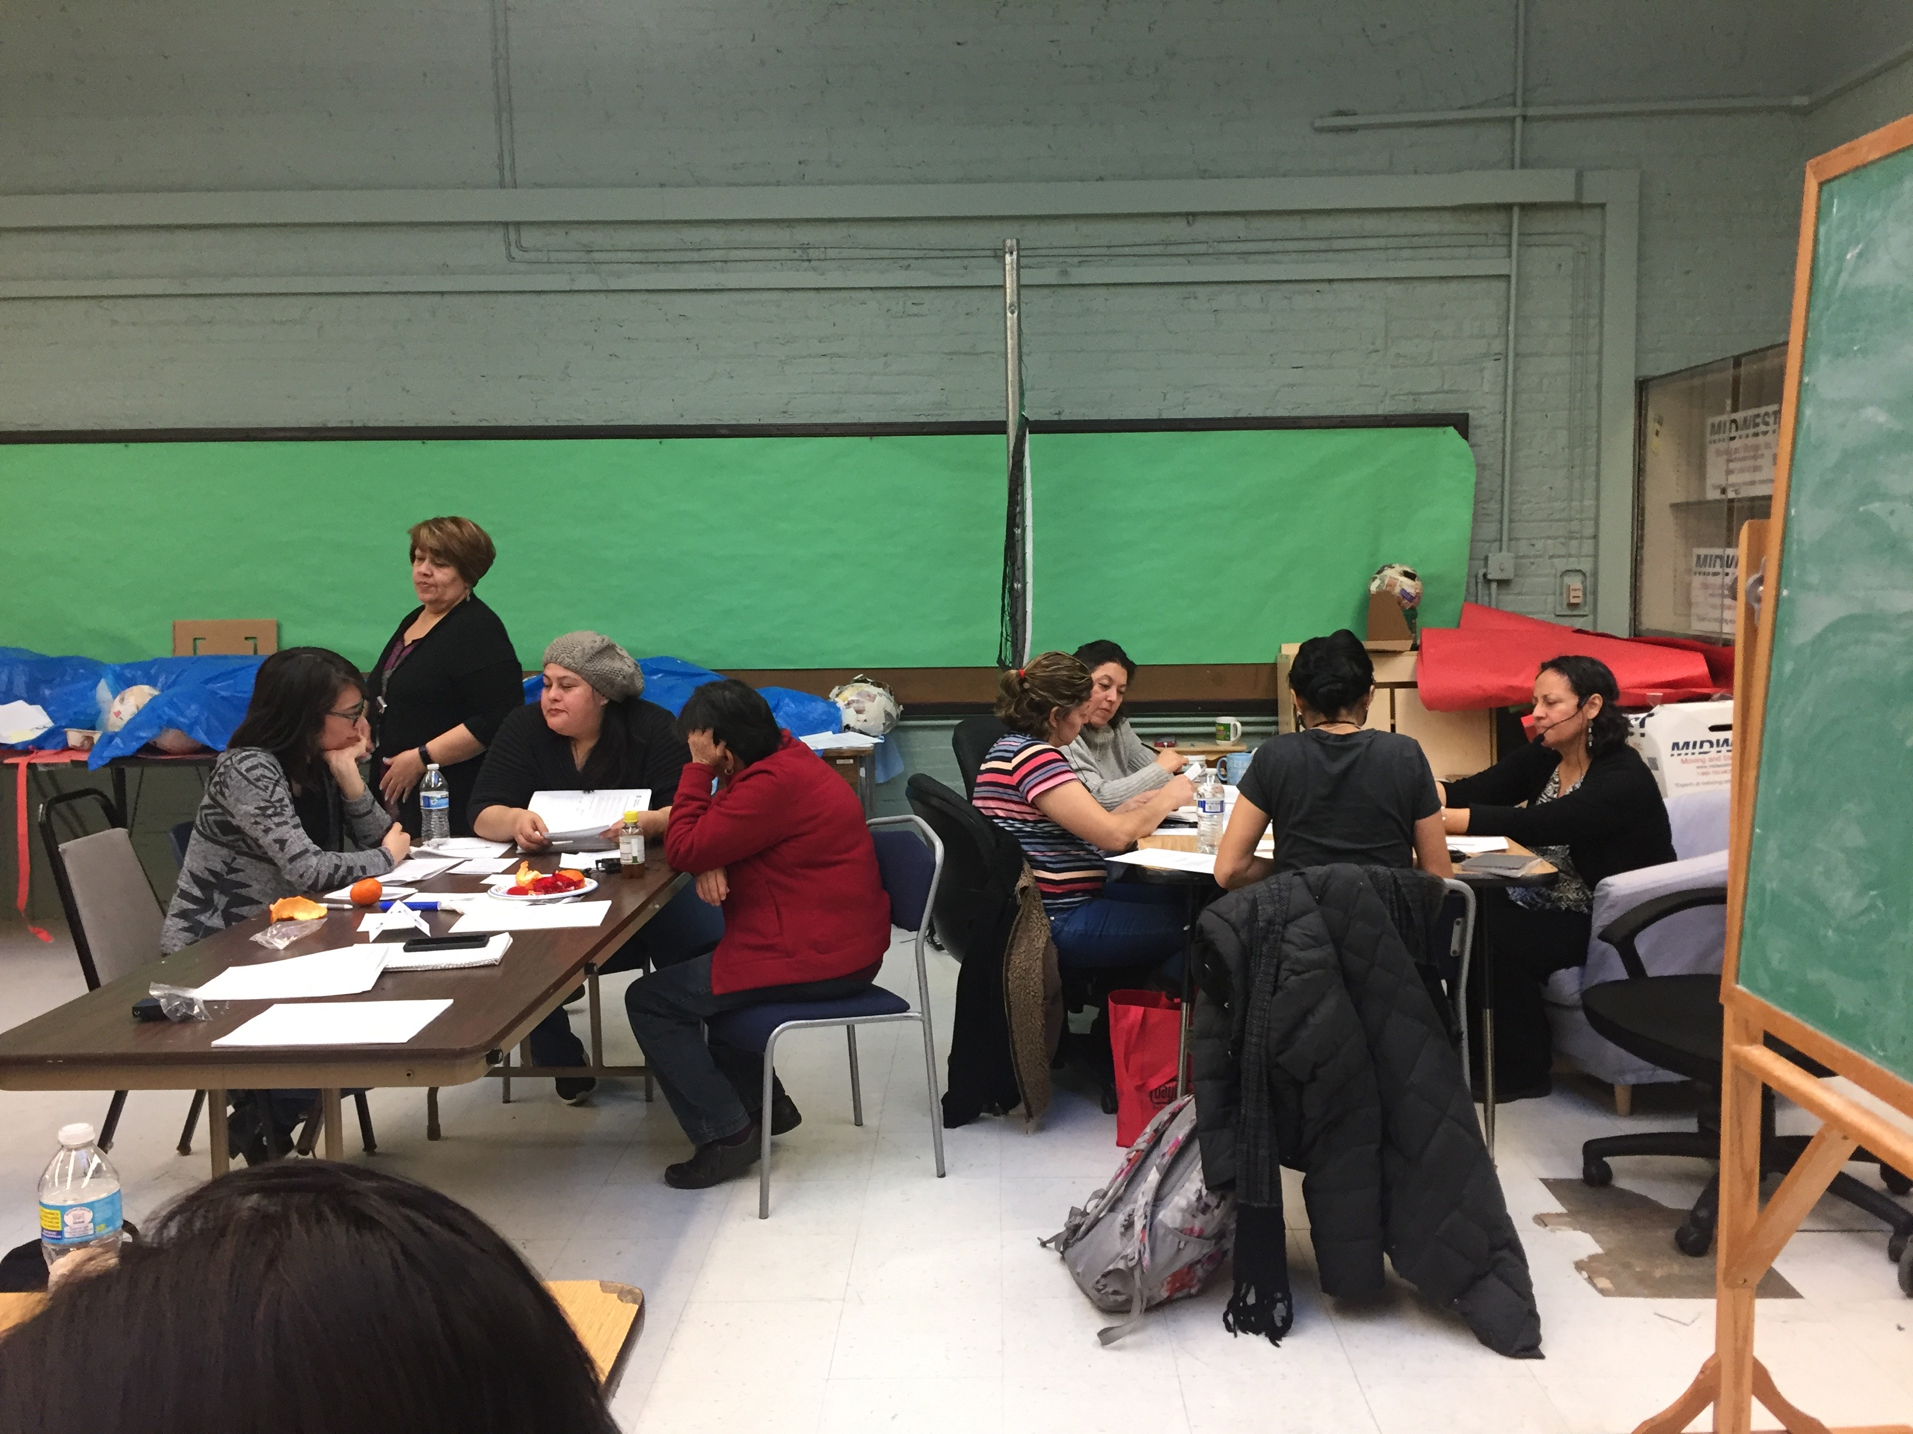
Research Partners
Linda Forst
Kathy Rospenda
Marsha Love
Jennifer Felner
Cindy San Miguel
Ana Genkova
Sarah Hernandez
Sandra Avela
Melissa Creshfield
Aeysha Chaudhry
Journie Raulston
Auturo Carrillo
Fanny Diego
Rev Bobby Smith
Brenda Palms-Barber
Jaqueline TCEP
Lara TCEP
Jeni Hebert-Beirne
Lorraine Conroy
Preethi Pratap
Sylvia Gonzalez
Alisa Velonis
Dolores Castañeda
Rodney Johnson
Alexis Grant
Maria Velazquez-TCEP
Patricia Pereda-TCEP
Adriana Magaña
Yvette Castañeda
Adlaide Holloway - SUHI
Suzanne Zoheri-SAH
Teresa Berumen-SAH
Madeline Woodberry-SUHI
Robert Calhoun-SAH
Angelica Rosales-SAH

Slide 7
Community-based Participatory Research
- Is a collaborative approach to research
- Equitably involves all partners
- Places primacy on the community’s issues of interest
- Recognizes the unique strengths that each bring
Researcher– research training and skills, funding, institutional support
Community partner – local knowledge, relationships in the community, personal stake in the research, ability to sustain interventions/changes
- Focuses on: social science + social activism ➔ social change
Notes:
Partners are academics, or Public health professionals, and community members.
Creating opportunities for social change through science and activism. Goal of Public Health.
Researchers transform tools for community members to analyze and decide on action
Community members transfer their expert content and meaning to researchers in pursuit of knowledge and application.

Slide 8
Method | Research Question
Interviews/ Entrevistas | What are the community’s needs and assets with respect to work?
Focus Groups/ Grupos de Enfoque | How do residents experience work? How does work impact health?
Community Health Survey/ Encuesta de Salud Comunitaria | What are the characteristics, barriers, pathways to work?
Concept Mapping/ Creación de mapas de ideas Y1 | FQ: “When I think of my work situation, or people who live in my community in similar work situations, one way work impacts our health (good or bad) is ____.”

Slide 9
Research Question | Method | Dissemination
What are the community’s needs and assets with respect to work? | Interview | APHA 2019 Manuscript in Development
How do residents experience work? How does work impact health? | Focus Group | Composite Stories Community Report GLHW Conceptual Model
What are the characteristics, barriers, pathways to work? | Community Health Survey | Stress and Health 2019 SCRA Symposium 2019
How do residents perceive work impacts their health? | Concept Mapping | APHA 2019 AJIM Under Revise and Resubmit Review SCRA Symposium 2019 GLHW Conceptual Model
Synthesis of Existing Data Sources | Secondary Data Analysis | Masters Thesis
What are the characteristics of workplaces in GL? | Investigation Observation | WWW Dataset Manuscript in development
What are the health needs of street vendors? | Secondary Data Analysis Observation | Poster Quilt

Slide 10
Greater Lawndale Healthy Work Project
Road Map 9/1/16-8/31/21
Organized Greater Lawndale Healthy Work Community Research Team
Concept Mapping
identified how residents see work impacting health
Interviews
Asked key community stakeholders what are key issues
Checked with with community residents on emerging findings
Focus Groups
Asked residents about work experiences
Survey
Ask residents about work characteristics
Action Mapping
Identify actions to take based on research findings
Test Actions
See which actions work best
Build a Culture of Occupational Health
We are here

Slide 11
Individual Interview
Alexis

Slide 12
Introduction
Interviews centered around work and health in the community
Work: labor that is done to support oneself and one’s family financially
Health: including not just the absence of disease, but health as encompassing wellness, safety, mental/social health, and factors that influence health. These include factors in the community itself, its surroundings, and the people who live in the community and social – are cultural influences of residents of the community
Community: defined as the geographic neighborhood of “Little Village” or “North Lawndale” specific to the informant’s experience
20 key Informant Interviews
4 in Spanish, 16 in English
10 conducted in Little Village, 10 conducted in North Lawndale

Slide 13
Coding Overview
Excerpts Overview
1-15 excerpts per interview
175 excerpts total
14 Codes
Parent codes:
Community Assets and Capacity
Action
Intervention Type

Slide 14
Code Frequency
Code | Total # Excerpts | Excerpts from LV | Excerpts from NL
Community Assets and Capacity: whenever an asset is mentioned that we can build on | 49 | 19 (38.3%) | 30 (61.2%)
Action: Identifies content that provides ideas for action and/or intervention on work
Society and Policy | 16 | 3 (18.8%) | 13 (81.3%)
Community | 45 | 15 (33.3%) | 30 (66.7%)
Employers | 19 | 9 (47.4%) | 10 (52.6%)
Family | 4 | 0 | 4 (100%)
Interpersonal | 6 | 1 (16.7%) | 5 (83.3%)
Individual | 50 | 17 (34%) | 33 (66%)
Intervention Type: describes what kind of intervention - behavioral, knowledge, social norms, policy
Build Community Capacity | 26 | 9 (34.6%) | 17 (65.4%)
Change Behavior | 27 | 4 (24.8 %) | 23 (85.2%)
Knowledge | 45 | 19 (42.2%) | 26 (57.8%)
Skill | 26 | 7 (26.9%) | 19 (73.1%)
Structural Intervention | 26 | 6 (23.1%) | 20 (76.9%)

Slide 15
Community Asset Summary
Coded at least once in every interview
Any specific mention of a community asset was coded; could be place, a positive characteristic of the community, resources, or programs
We would use these codes once we have an intervention target/type in mind
To identify potential intervention sites
To identify ways to build on what is already happening in the community (versus starting from scratch)
To examine if the intervention fits in the history of the community/ builds off an intervention that has been effective in the past

Slide 16
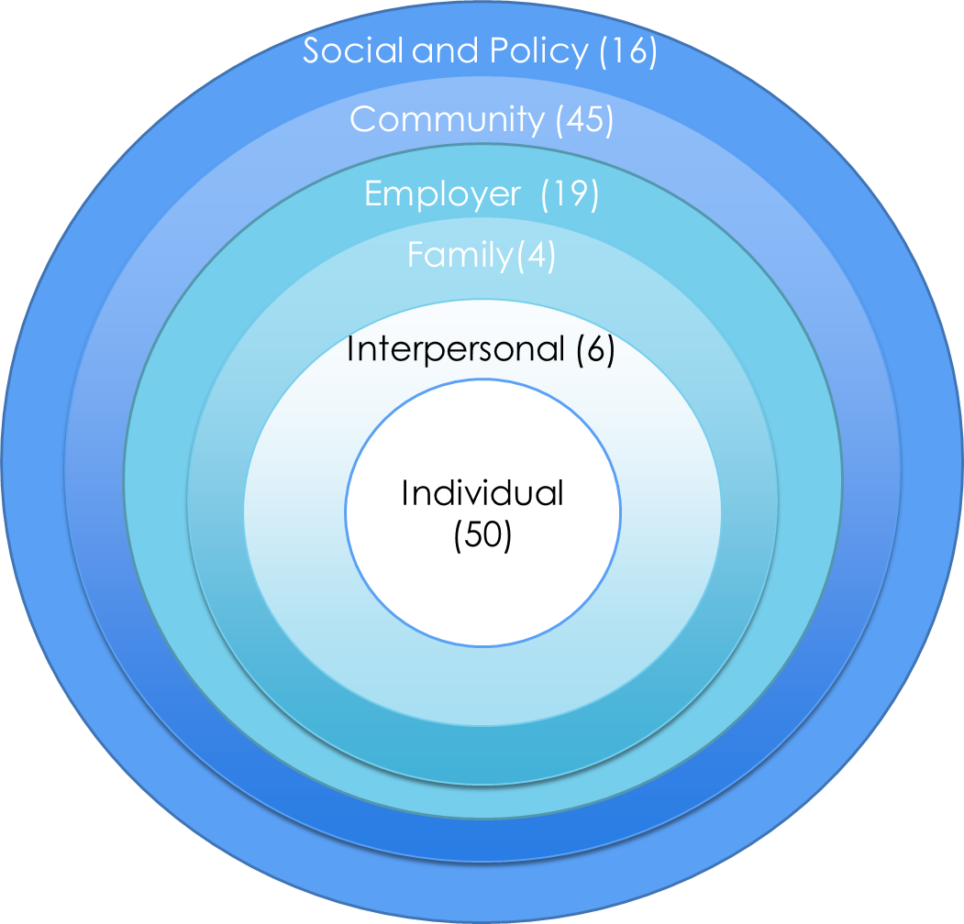
Action Level Summary
Individual, Community, and Society levels most common
Individual (18/20 interviews)
interview prep, resume building, job search assistance, learning professional behavior, job skills
“second chance” programs for people coming from jail, organizations vouching for individuals
Increasing knowledge about worker rights, places to work
Budgeting and banking training
Resources for entrepreneurs, small business incubator
For youth: mentoring youth for goal setting; summer program for youth in jobs, “teach youth a trade”
Programs to encourage mental shift away from dependency
Interpersonal (4 interviews)
Social support and encouraging others
Mentoring youth
Working together across race lines, “stop using color”

Slide 17
Action Level Summary, Cont.
Family (4 interviews)
Youth employment programs
Mentoring and family structure support
Employers (11 interviews)
Increase value for community
Change hiring practices (hire people with records, offer training)
Offering career paths to people in the neighborhood
Internal Policy changes: childcare, wellness programs
Addressing misconceptions and fears about immigrants

Slide 18
Action Level Summary, Cont.
Community (16 interviews)
Local campaigns (for knowledge and policy)
Supporting entrepreneurs
Mentoring
Job training/skill building
Community engagement, knowledge sharing
Reducing Stress
Society and Policy (12 interviews)
Equitable, quality education
Sick time and vacation time policies
Expand transportation
Do something with vacant buildings
Housing assistance and affordable housing
Increase Wages

Slide 19
Takeaways
Useful for action mapping and intervention implementation
Most common intervention goal was increasing knowledge
Contrasts FG findings and suggests that key informants do not have the same perception of the problem
Most common level of intervention were individual, or community
Contrasts FG emphasis on societal, policy, and employer responsibility

