Slide 1
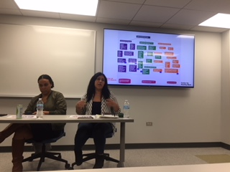
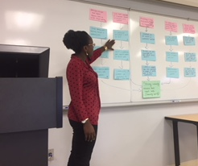
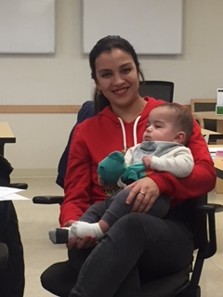
Greater Lawndale Healthy Work Project
CHW Retreat Day 1 Sept 9, 2019

Slide 2
Center for Healthy Work A NIOSH Center of Excellence for Total Worker Health®
A research and education center (est. 2016) to advance the health and well being of workers in Chicago, the state of Illinois, and the nation.
Mission: to remove barriers that impact the health of low wage workers in the increasingly contingent workforce.
Aims: to identify and promote employment programs, practices, and policies that will improve worker and community health locally, across the state, and throughout the nation.
Everyone has the right to a healthy job
Notes:
SLIDE 6: In conveying some of the ideas of how health inequities are produced and maintained I’ll be sharing some of what we are learning in our National Institutes of Occupational Safety and Health-funded Center for Healthy Work at UIC. Specifically, our research core has been engaged in participatory research in Chicago neighborhoods that have a large proportion of the residents engaged in what we refer to as precarious work situations. This is relevant to our topic today as our Center’s mission is to to remove barriers that impact the health of low wage workers in the increasingly contingent workforce and we have a social justice emphasis that Everyone has the right to a healthy job. Barriers to work and health and human rights are of central interests in our research and in this webinar.

Slide 3
Goal/Meta
The goal is to establish a culture of occupational health in communities that will move people from precarious to healthy work by increasing community capacity for addressing healthy work.
El objetivo del Proyecto de trabajos saludables de “Greater Lawndale” es para establecer una cultura de salud ocupacional en comunidades, donde las personas pasaran de precarias condiciones hacia condiciones saludables de trabajo, incrementando la capacidad de la comunidad, enfocándonos en trabajos saludables.

Slide 4
Greater Lawndale Healthy Work Project Aims
Determine the context of, and barriers and pathways to healthy work in two neighborhoods in Chicago that experience high socio-economic hardship: Little Village and North Lawndale.
Build community capacity to recognize worker health as an important determinant of community health, address work-related health in community total worker health efforts, and sustain effective, newly developed community-based worker health promotion interventions.

Slide 5
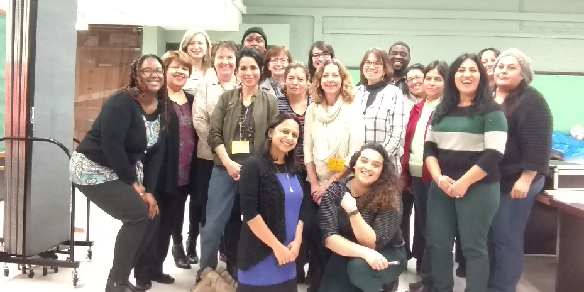
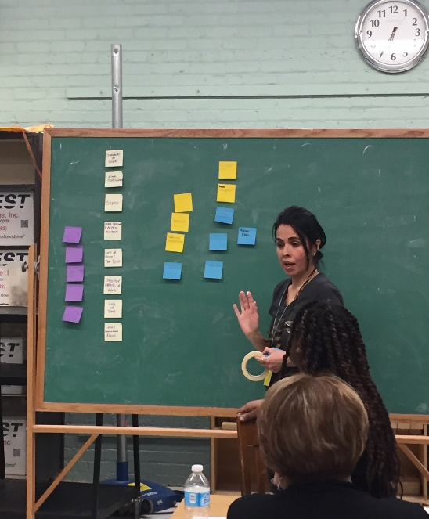
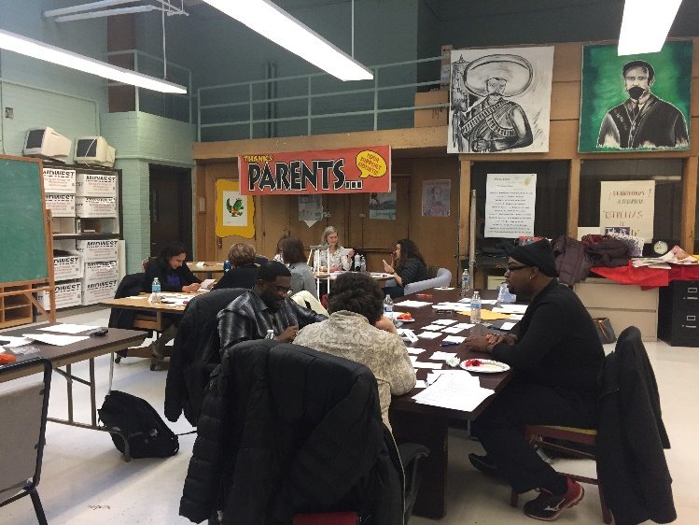
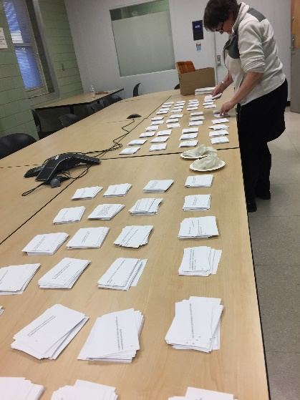
Exploring Precarious Work to Build a Culture of Occupational Health at Community Level
Notes:
SLIDE 6: In the Center for Healthy Work, our study is examining from a CBPR perspective, in which we are researching in partnership with people best informed on the topic, how people experience work at the community level. We are using mixed methods to be able to describe how work functions as a social determinant of health. In doing so we are collecting and piecing together stories of people engaged in precarious work.

Slide 6
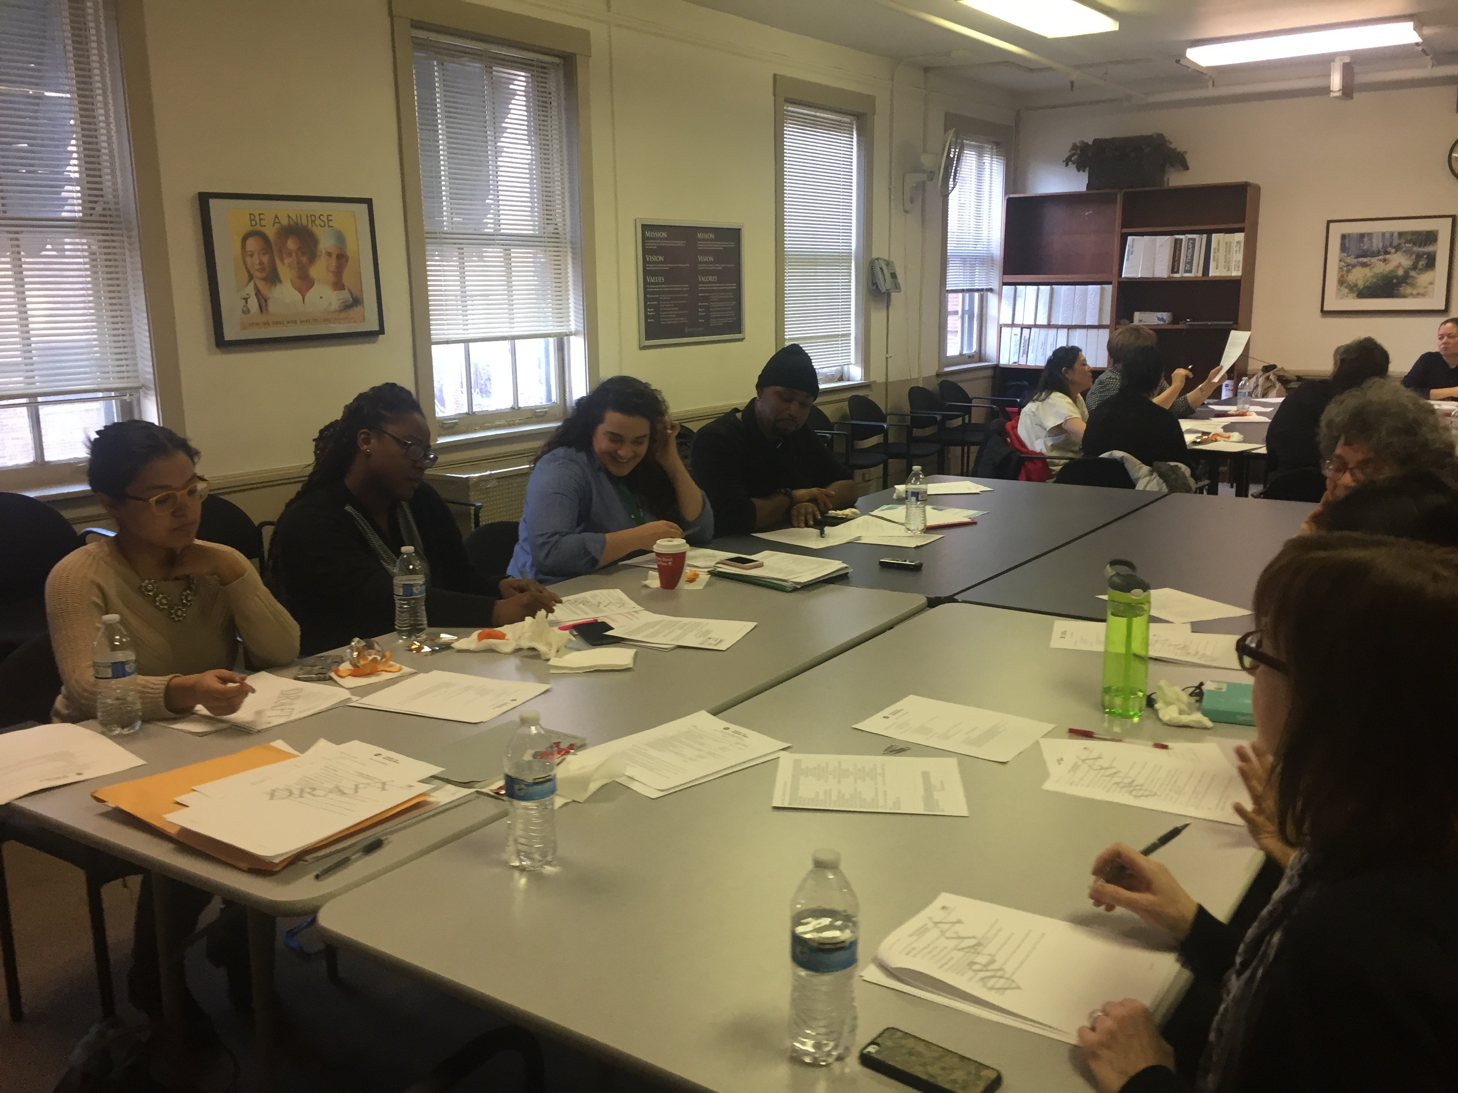
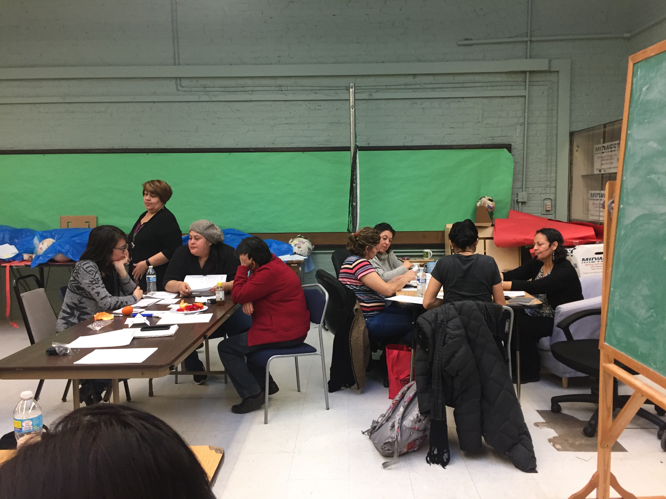
Research Partners
Linda Forst
Kathy Rospenda
Marsha Love
Jennifer Felner
Cindy San Miguel
Ana Genkova
Sarah Hernandez
Sandra Avela
Melissa Creshfield
Aeysha Chaudhry
Journie Raulston
Auturo Carrillo
Fanny Diego
Rev Bobby Smith
Brenda Palms-Barber
Jaqueline TCEP
Lara TCEP
Jeni Hebert-Beirne
Lorraine Conroy
Preethi Pratap
Sylvia Gonzalez
Alisa Velonis
Dolores Castañeda
Rodney Johnson
Alexis Grant
Maria Velazquez-TCEP
Patricia Pereda-TCEP
Adriana Magaña
Yvette Castañeda
Adlaide Holloway - SUHI
Suzanne Zoheri-SAH
Teresa Berumen-SAH
Madeline Woodberry-SUHI
Robert Calhoun-SAH
Angelica Rosales-SAH

Slide 7
Community-based Participatory Research
- Is a collaborative approach to research
- Equitably involves all partners
- Places primacy on the community’s issues of interest
- Recognizes the unique strengths that each bring
Researcher– research training and skills, funding, institutional support
Community partner – local knowledge, relationships in the community, personal stake in the research, ability to sustain interventions/changes
- Focuses on: social science + social activism ➔ social change
Notes:
Partners are academics, or Public health professionals, and community members.
Creating opportunities for social change through science and activism. Goal of Public Health.
Researchers transform tools for community members to analyze and decide on action
Community members transfer their expert content and meaning to researchers in pursuit of knowledge and application.

Slide 8
Method | Research Question
Interviews/ Entrevistas | What are the community’s needs and assets with respect to work?
Focus Groups/ Grupos de Enfoque | How do residents experience work? How does work impact health?
Community Health Survey/ Encuesta de Salud Comunitaria | What are the characteristics, barriers, pathways to work?
Concept Mapping/ Creación de mapas de ideas Y1 | FQ: “When I think of my work situation, or people who live in my community in similar work situations, one way work impacts our health (good or bad) is ____.”

Slide 9
Research Question | Method | Dissemination
What are the community’s needs and assets with respect to work? | Interview | APHA 2019 Manuscript in Development
How do residents experience work? How does work impact health? | Focus Group | Composite Stories Community Report GLHW Conceptual Model
What are the characteristics, barriers, pathways to work? | Community Health Survey | Stress and Health 2019 SCRA Symposium 2019
How do residents perceive work impacts their health? | Concept Mapping | APHA 2019 AJIM Under Revise and Resubmit Review SCRA Symposium 2019 GLHW Conceptual Model
Synthesis of Existing Data Sources | Secondary Data Analysis | Masters Thesis
What are the characteristics of workplaces in GL? | Investigation Observation | WWW Dataset Manuscript in development
What are the health needs of street vendors? | Secondary Data Analysis Observation | Poster Quilt

Slide 10
Greater Lawndale Healthy Work Project
Road Map 9/1/16-8/31/21
Organized Greater Lawndale Healthy Work Community Research Team
Concept Mapping
identified how residents see work impacting health
Interviews
Asked key community stakeholders what are key issues
Checked with with community residents on emerging findings
Focus Groups
Asked residents about work experiences
Survey
Ask residents about work characteristics
Action Mapping
Identify actions to take based on research findings
Test Actions
See which actions work best
Build a Culture of Occupational Health
We are here

Slide 11
Where Workers Work Assessment
Linda

Slide 12
Methods
Go to: http://www.ides.illinois.gov/Pages/mission.aspx Read About IDES (Mission and Vision, Letter from the Director, Glossary of Terms
Click Tools and Resources; then Data and Statistics. Scroll down to Where Workers Work and click. This will get you to http://www.ides.illinois.gov/LMI/Pages/Where_Workers_Work.aspx
Read this webpage. Look up what a NAICS code is. (What are other “employer-type/sector” coding systems?) Read what is in UI data, found in this narrative. What is QCEW? What do they say are the limitations of this database?
Scroll to the bottom and find employers (who reported UI info to IDES); download the spreadsheet (excel) for 2018—should be most current and in real-time (ie, anyone that went out of business in past years will not be in this database)
Tables 9-16 of the spreadsheet provide data on Chicago zipcodes. We are interested in Chicago community areas which are the aggregate of census tracts and census blocks. Zipcodes do not overlay perfectly with community areas so this is your first challenge.
Check out the relationship between zip codes and community areas here http://robparal.blogspot.com/2013/07/chicago-community-area-and-zip-code.html Identify what zip codes you need to examine for this assignment.
Extract the Sectors that have employees in them. Note the NAICS code narrative for that sector. Find the definition of the NAICS code to inform your investigation https://www.census.gov/eos/www/naics/
Your goal is to find the actual employers—the names of the companies—through at last 3 means:
Internet search. Start with Google, and enter the sector and the zipcode. See if you can get employer names and addresses. Then use google and other search engines to enhance your list.
Go to Google Maps. List familiar work types within a NAIS code (e.g., grocery stores)
3. Go to the UIC Library site. We have access to Hoovers, which is a business listing of every business. See if you can find the actual employers here. Read about strengths and limitations of Hoovers. Reporting is voluntary and you can’t distinguish headquarters or the whole company from the individual site in the neighborhood. But corroboration might help.
4. Do a street based survey, first virtual (windshield survey using googlearth, e.g.), then walking up and down the streets to figure out what employers are there.
5. End with a list of companies, addresses, sector label, number of employees. Populate the google sheet on Blackboard.
assembled data on employers in GL
used existing data sources
searched internet sites
conducted walking observations
recorded:
name of the company
the economic sector
number of employees
exact location of the business
student investigators recorded observations and insights
Assignment Guidelines

Slide 13
Findings
1127 employers in 2 communities (roughly one zipcode)
Sources: Hoover’s business listing (n=383); Googlemaps (738)
391 businesses validated in person
85% of the 727 employers where size could be documented had <20 employees
Over ½ of employers are in retail, service, food sectors.
Students observed informal (cash economy) employment including prostitution, drug sales, food vending
46% of GL employers fall into manufacturing and healthcare.
Students found instances of phantom businesses and linked their awareness of employment that is not visible (childcare, cleaning, independent contractors) to the investigation.

Slide 14
Sector Title (NAICS) | # GL Employers* | % GL employers by sector* | Where GL workers work** | % GL workers by sector**
Retail/wholesale (42,44,45) | 286 | 25.4 | 1101 | 10.0
Services (81) | 209 | 18.5 | 495 | 4.5
Finance, real estate, consulting, etc (50s) | 145 | 12.9 | 1091 | 9.9
Accommodation, food, entertainment (72) | 140 | 12.4 | 1042 | 9.5
Education (61) | 72 | 6.4 | 551 | 5.0
Healthcare (62) | 71 | 6.3 | 2298 | 20.9
Manufacturing (31-33) | 65 | 5.8 | 2763 | 25.2
Construction (23) | 47 | 4.2 | 545 | 5.0
Transport., warehousing (48-49) | 41 | 3.6 | 200 | 1.8
Arts, Entertainment, Recreation (71) | 20 | 1.8 | 30 | 0.3
Public Admin (91) | 17 | 1.5 | 0 | 0.0
Unknown | 14 | 1.2 | 867 | 7.9
Total | 1127 | 100% | 10,983 | 100%
*From student’s community survey, Spring 2019 **From Illinois Department of Employment Securities, Unemployment Insurance data, 2017 http://www.ides.illinois.gov/LMI/Where%20Workers%20Work/2017.PDF Unemployment insurance data are not available yet for 2019; in Illinois, most for-profit employers must pay UI if they have either paid $1500 in wages in a single calendar quarter or have employed one or more persons for 20 weeks in a given calendar year. Farm workers, domestic workers, and non-profit employees have different rules. Illegal (cash economy) and undocumented workers are not included.
Businesses & workforce in GL,
by sector

