Slide 1
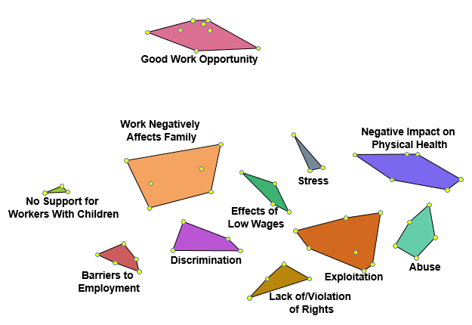
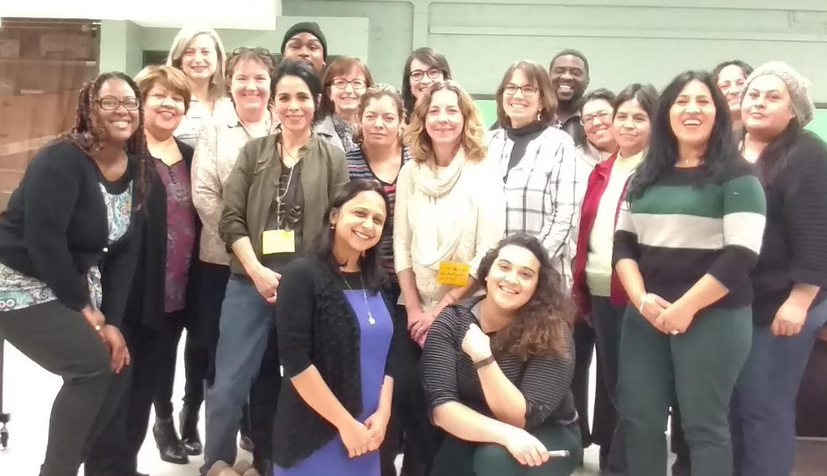
Understanding Precarious Work from a Community Perceptive Utilizing Concept Mapping
Marcella Hernández, MPH Candidate
University of Illinois at Chicago, School of Public Health
Introduction
Results
Discussion & Recommendations
Why Precarious Work (PW) and Community Health?
Work affects individuals, their families and the community
Little is known about how work operates as a social determinant of health at the community level
PW is associated with hazardous working conditions, material deprivation, adverse health outcomes and negative quality of life
Low-wage workers are more likely to be women, Hispanic, African-American, foreign-born, under 24 yo and lacking a high school diploma
Why Little Village (LV) in preference to other Chicago communities?
Has the lowest per capita income of $11,333
Highest percentage of adults > 25 yo without a high school diploma
88% LV residents reported being of Mexican descent, 45% being foreign-born
Discussion
Complements existing research by providing a community perspective on the relationship between work and health
CM is a CBPR tool that can help dissect heterogeneity within seemingly homogeneous groups
Previously identified precarious work constructs appeared in the results: job insecurity, insufficient wages, limited workplace rights
Results identify and prioritize the needs of the community
Items identified by the community within clusters allow community-based organizations (CBOs) to carefully orient to more specific issues and plan narrower interventions to address multi-faceted precarious work themes
Overall, this approach builds community awareness and capacity to reduce work-related exposures and work towards health equity
Recommendations
Use this tool more widely to build community capacity in providing community-based organizations “with the tools to act as equal partners in implementing intervention programs.”
Use this approach to inform development of tailored interventions for health equity by:
-Creating more effective, innovative, culturally-appropriate
interventions compared to past efforts
- Encouraging community-level interventions to lead to policy
change
Explore these results to develop a conceptual model on the drivers of precarious work’s impact on health
Objectives
Greater Lawndale Healthy Work (GLHW) team conducted a community-based participatory project using Concept Mapping (CM) to:
Identify the perceived work-related factors impacting health in LV, a predominantly Mexican-immigrant community
Develop a community-driven model that explains the relationships between work and health
Methods
Fig. 2: Work Impacting Community Health Cluster Analysis. 55 items clustered into 11 different themes. Dots closer together represent statements that were more often sorted together and similarly related. Dots further apart are less likely to be related.
Phase 1: Engage Community Partners
Six Spanish-speaking (4 bilingual) LV community researchers (CRs) trained by UIC partners in Human Subjects and Concept Mapping
Validated an English and Spanish focal question: “When I think of my work situation, or people who live in my community in similar work situations, one way work impacts our health (good or bad) is ___.”
“Cuando pienso de mi situación de trabajo, o la situación de la gente quien vive en mi comunidad que trabajan de formas similares, una manera que el trabajo impacta nuestra salud (bueno o malo) es ___.”
Phase 2: Brainstorming (BrS) and Sorting & Rating (S&R)
CRs engaged participants in brainstorming in LV community settings
Responses received in English or Spanish (31% in Spanish; N = 79)
Conducted “member checking” and reduction of 259 statements to 55 items.
Organized Sorting & Rating sessions within the community
Participants systematically sorted 55 items into piles &, labeled each pile with their own descriptor/theme; team recorded results
Participants rated 55 items using a Likert 1-6 scale based on perceived community prevalence and health impact
Phase 3: Data Analysis
CS Global MAX 2017.023.15 was used for data analysis.
Key References
Fig. 1: Sample Demographics (N = 75)
Baron, S. L., Beard, S., Davis, L. K., Delp, L., Forst, L., Kidd-Taylor, A., …Welch, L. S. (2014). Promoting integrated approaches to reducing health inequities among low-income workers: Applying a social ecological framework: Approaches to reducing health inequities. American Journal of Industrial Medicine, 57(5), 539-556. Doi: 10.1002/ajim.22174
Baron, S., Sinclair, R., Payne-Sturges, D., Phelps, J., Zenick, H., Collman, G. W., & O’Fallon, L. R. (2009). Partnerships for environmental and occupational justice: Contributions to research, capacity and public health. American Journal of Public Health, 99(S3), S517-S525. Doi: 10.2105/AJPH.2009.174557
Benach, J., Vives, A., Amable, M., Vanroelen, C., Tarafa, G., & Muntaner, C. (2014). Precarious employment: Understanding an emerging social determinant of health. Annual Review of Public Health, 35(1), 229-253. Doi: 10.1146/annurev-publhealth-032013-182500
Burke, J. G., O’Campo, P., Peak, G. L., Gielen, A. C., McDonnell, K. A., & Trochim, W. M. K. (2005). An introduction to concept mapping as a participatory public health research method. Qualitative Health Research, 15(10), 1392-1410. Doi: 10.1177/1049732305278876
Dirksen JC, Prachand NG, et al. Healthy Chicago 2.0: Partnering to Improve Health Equity. City of Chicago, March 2016. Retrieved from https://www.cityofchicago.org/content/dam/city/depts/cdph/CDPH/HC2.0Plan_3252016.pdf
Kane, M., & Trochim, W. M. (2007). Concept mapping for planning and evaluation. Thousand Oaks, CA: Sage Publications.
Trochim, W. M. K. (1989). An introduction to concept mapping for planning and evaluation. Evaluation and Program Planning, 12(1), 1-16. Doi: 10.1016/0149-7189(89)90016-5
Wallerstein, N., & Duran, B. (2010). Community-based participatory research contributions to intervention research: The intersection of science and practice to improve health equity. American Journal of Public Health, 100(S1), S40-S46. Doi: 10.2105/AJPH.2009.184036
Stress
Community Prevalence
5.11
4.97
Health Impact
Stress
Negative Impact on Physical Health
Women
5.13
4.77
Men
Stress
Barriers to Employment
No Support for Workers with Children
Negative Impact on Physical Health
Work Negatively Affects Family
Stress
Work Negatively Affects Family
Negative Impact on Physical Health
Work Negatively Affects Family
Negative Impact on Physical Health
Barriers to Employment
Exploitation
Barriers to Employment
Exploitation
Exploitation
Lack of/Violation of Rights
Effects of Low Wage Work
Abuse
Lack of/Violation of Rights
Abuse
Discrimination
No Support for Workers with Children
Work Negatively Affects Family
Exploitation
Discrimination
No Support for Workers with Children
Discrimination
No Support for Workers with Children
Lack of/Violation of Rights
Barriers to Employment
Abuse
Acknowledgements
Abuse
Effects of Low Wage Work
Effects of Low Wage Work
Lack of/Violation of Rights
Greater Lawndale
Health Work Team
The research was supported by a pilot project grant from the Illinois Occupational Health and Safety Education and Research Center (NIOSH Grant T42/OH008672)
Good Work Opportunity
Discrimination
Good Work Opportunity
3.89
3.74
Good Work Opportunity
Good Work Opportunity
3.84
r = 0.73
3.72
Effects of Low Wage Work
Fig. 3: Pattern Match Display Comparing Community Prevalence and Health Impact by Cluster. Clusters rated closer to 6 were perceived as more important than clusters rated closer to 1.
r = 0.81
Fig. 4: Pattern Match Display Comparing Men’s and Women’s Views on How 55 Work-Related Items Impacts Community Health.
Notes:
Questions:
Intro: correct to say “foreign-born”? Would I cite CHA or HC 2.0?
-So what??
-income, education, undocumented→ used as a proxy. Show that this community is most likely to have precarious jobs.
-A lot of the data was driven by women
-manual look at employment and education
-per capita income = avg income per person
-Add abbreviations in poster in separate box.
-step 6: “action plans”
-step4, 5, 6 have weird arrows
-Fig. 2: Perceived Amount of People Affected
-Explain scale (6 a lot of people/a lot of impact on health vs 1)
-last, first name (ABC order)
-red = HIV, women paper
-first yellow: Benach, 2014

