Slide 1
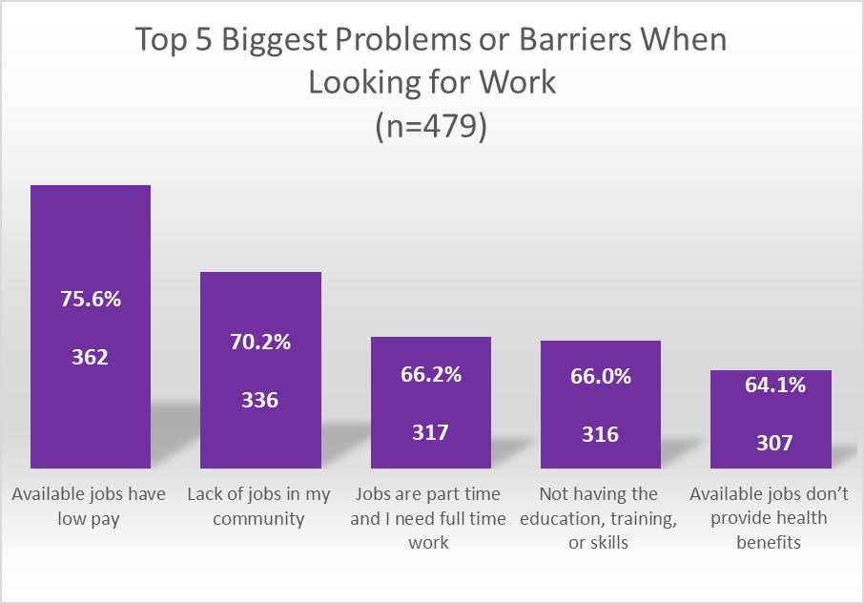
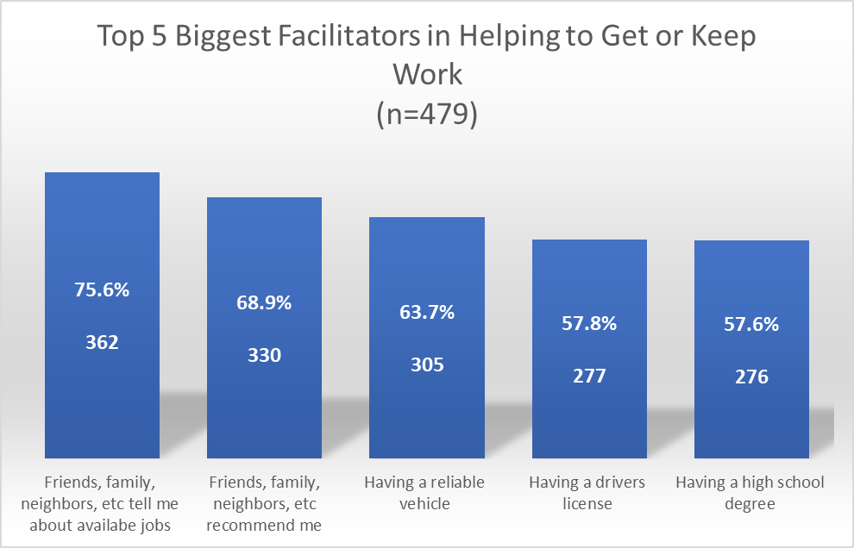
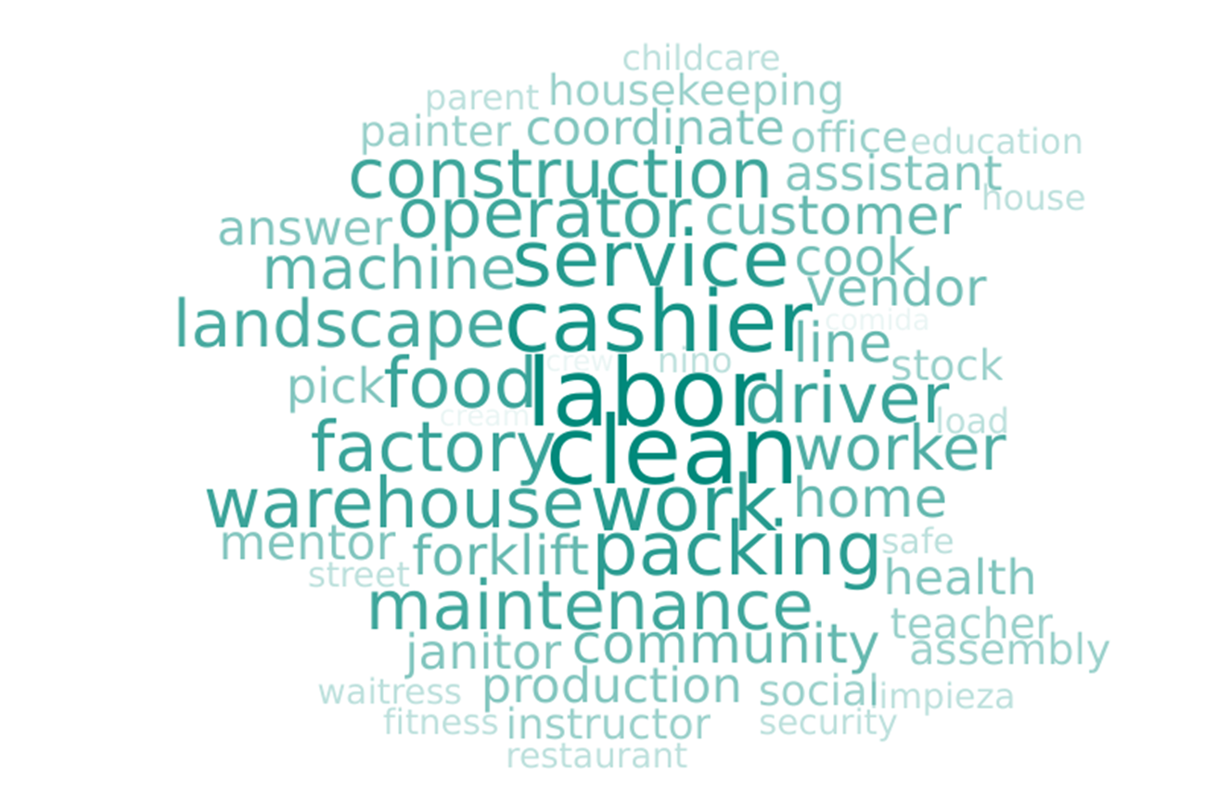
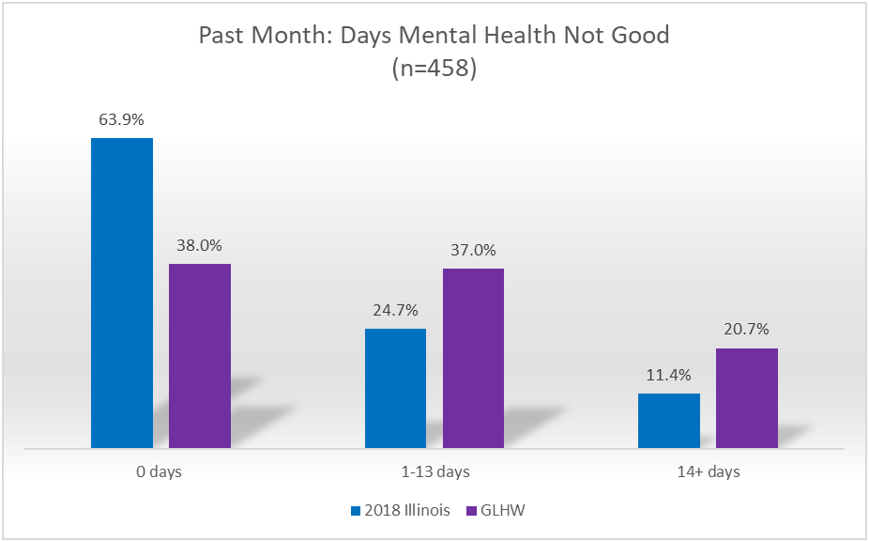
Precarious Employment and Community Health in a High Hardship
Community: Data from the Greater Lawndale Healthy Work Survey
Kathleen M. Rospendaª, Jeni Hebert-Beirneª, Lorraine Conroyª, Dolores Castañedaª, Sylvia Gonzalezª, Teresa Berumen^{b}, Linda Forstª,
& The Greater Lawndale Healthy Work Project Research Team; ªUniversity of Illinois at Chicago School of Public Health; ^{b}Rush Hospital | Chicago, Illinois
Background
Results
Conclusion
The Greater Lawndale Healthy Work (GLHW) Project is a community-based participatory research study affiliated with University of Illinois at Chicago’s Center for Healthy Work, a Center of Excellence in Total Worker Health®. Results presented are from the GLHW Survey, characterizing the nature of work and health for two neighbor-hoods in Chicago experiencing high socio-economic hardship: Little Village and North Lawndale (i.e., Greater Lawndale). Data characterize 1) the nature of work, 2) the most prevalent barriers and pathways to work, and 3) the association of employment precarity with health-related outcomes in Greater Lawndale.
Greater Lawndale (GL) residents face issues finding full-time jobs that offer decent wages and benefits, and that are in the community.
Social connections, transportation, and education were the biggest facilitators of finding and keeping work.
Work was precarious for GL residents in terms of issues of income, job security and stability, and lack of benefits.
Employment precarity was associated with poorer mental & physical health of residents.
Combined with results from other qualitative data collection methods, the GLHW Survey results are informing development of community-based interventions to promote healthy work and support community health in Greater Lawndale.
28% on-call, day labor, temp work
71% no benefits
33% get at least ½ work hours from temp agencies
78% not paid if miss work
71% income varies week-to-week
56% no say over work schedule
65% paid by hour
Types of work in which GL residents were engaged
29% paid in cash at least sometimes
Methods
41% face regular changes to work schedule
37% likely to lose job in next year
Community Researchers recruited/ surveyed Greater Lawndale residents (LV n=246; NL n=233) age 18+ engaged in precarious work in past 2 years ($25 incentive), Aug 2018-Aug 2019.
46% women; 52% Latinx; 40% Black; mean age 38; modal residency 20 yrs; 75% currently employed
33.3% conducted in Spanish
24% wage theft
14+ days of poor mental or physical health in the past month was associated with…
Frequent changes to work schedule
Perceived likelihood of job loss
Experienced wage theft
Acknowledgements
This work was supported by CDC/NIOSH under grant number U19 OH011232. Views expressed in this poster or by the authors do not necessarily reflect the official policies of the Department of Health and Human Services, nor does the mention of trade names, commercial practices, or organizations imply endorsement by the U.S. Government.
Total Worker Health® is a registered trademark of the U.S. Department of Health and Human Services (HHS). Participation by the UIC Center for Healthy Work does not imply endorsement by HHS, the Centers for Disease Control and Prevention, or the National Institute for Occupational Safety and Health.

